Slide 1
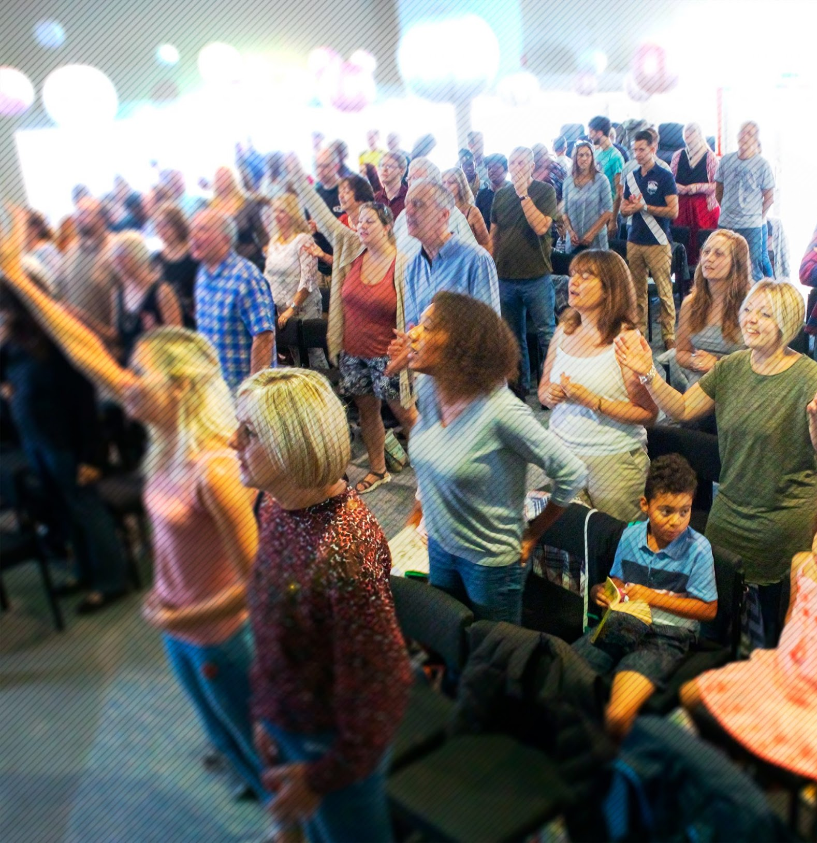
Jubilee Connects
Welcome to our virtual
Sunday gathering!
Enjoy the worship!
We’ll be starting shortly after 1030
Switch on your video so we can see you!
Please use a recognisable name onscreen.
You can send us all a message in the Chat window in Zoom but we’ve muted your voices to save background noise!

Slide 2


Slide 3

THE NATIONS

Slide 4

NIGERIA

Slide 5
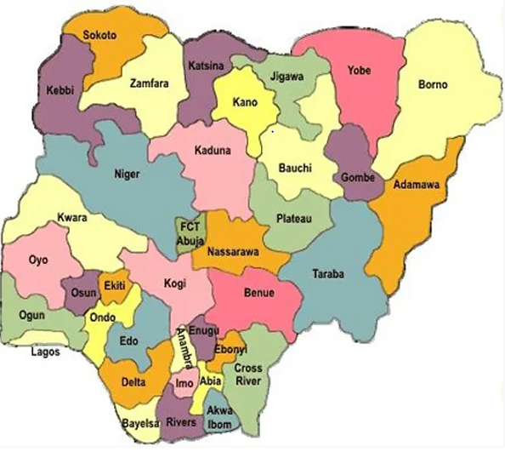

Slide 6
Some Facts About Nigeria
Nigeria officially called the Federal Republic of Nigeria
It is a sovereign country located in West Africa bordering Niger in the north, Chad in the northeast, Cameroon in the east, and Benin in the west. Its southern coast is on the Gulf of Guinea in the Atlantic Ocean.
Nigeria is made up of 36 states and the Federal Capital Territory, with Abuja as the federal capital territory and Lagos as the commercial nerve centre of the country.
Nigeria is inhabited by more than 250 ethnic groups with over 500 distinct languages all identifying with a wide variety of cultures
The three largest ethnic groups are the Hausa–Fulani in the north, Yoruba in the west, and Igbo in the east; comprising over 60% of the total population.
The official language of Nigeria is English. Currency is the naira and pidgin english the everyday slang

Slide 7
Some Facts About Nigeria
Nigeria is divided roughly in half between Christians, who live mostly in the southern part of the country, and Muslims, who live mostly in the north.
Estimated population is 206 million
Nigeria is usually called the giant of Africa and nicknamed Naija and the most populous country in Africa and has the largest economy in Africa.
Nigeria is the biggest black nation in the world in terms of population. It is believed that for every 4 blacks you meet one is a Nigeria.
Nigeria has respectively, the fifth-largest Muslim population in the world and the sixth-largest Christian population in the world
Staple food in Nigeria are Pounded Yam, Jollof Rice, Garri, Efo Riro, Egusi Soup, Suya (Marinated Barbequed Beef), Afang soup, Moi Moi, pepper soup, Tuwo Shinkafi, Nkwobi, Ewa Aganyin (specially made beans), amala and ewedu, fried plantain, ogbono soup etc.

Slide 8
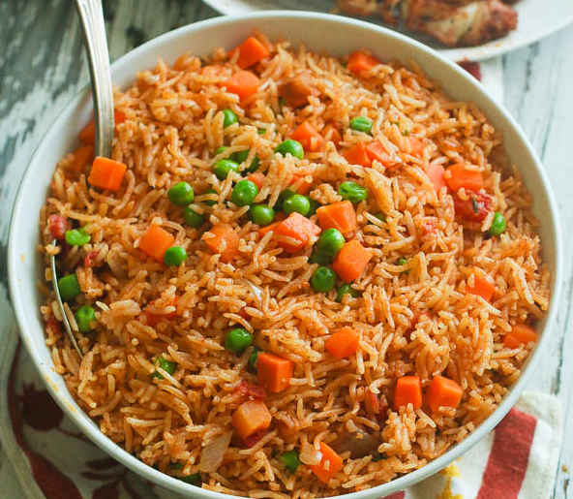
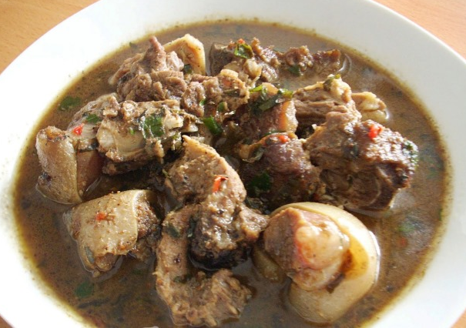
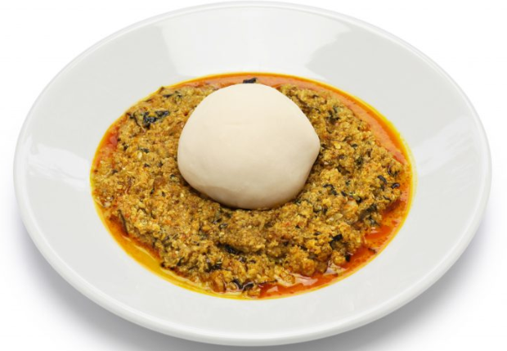
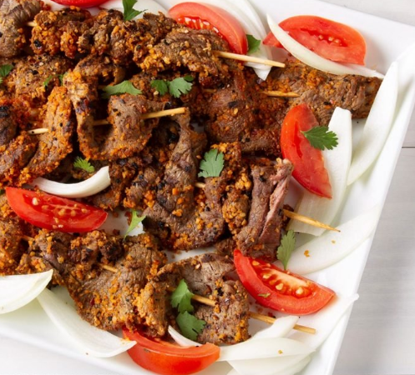
Food
Jollof Rice
Pepper Soup
Pounded Yam & Egusi
Suya

Slide 9
Some Humorous Facts About Nigeria
Nigerian tend to answer ask questions as part of normal conversations
E.g. You just walked into my house and the first thing I ask you is….have
you arrived?
Nigerians tend to put o….behind every sentence for emphasis
Nigerians tend to see the humorous side of every situation, no matter how grave the situation might be.

Slide 10
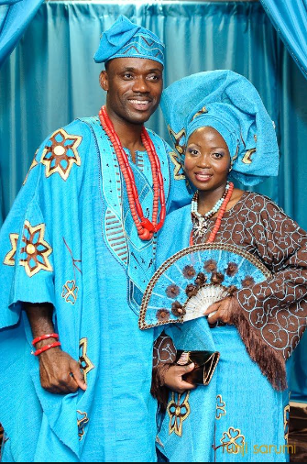
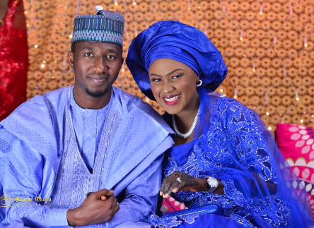
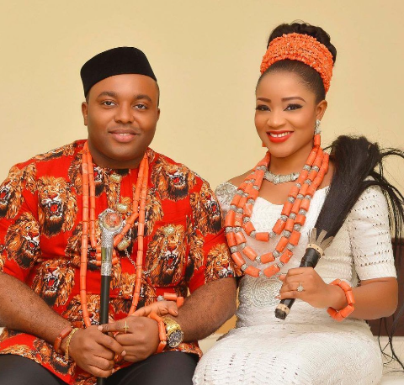
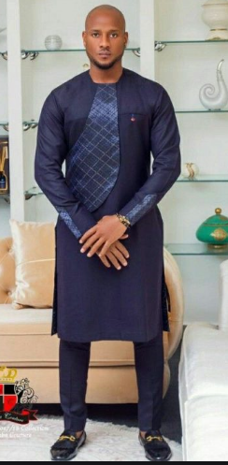
Some traditional attires

Slide 11


Slide 12

Fighting fear with faith

Slide 14
1 Cor 13:4-8 (NIV)
4 Love is patient, love is kind. It does not envy, it does not boast, it is not proud. 5 It does not dishonor others, it is not self-seeking, it is not easily angered, it keeps no record of wrongs. 6 Love does not delight in evil but rejoices with the truth. 7 It always protects, always trusts, always hopes, always perseveres.
8 Love never fails.
Why should we prophesy?
1 Cor 14:1 (NIV)
Follow (pursue) the way of love (agape) and eagerly desire gifts of the Spirit, especially prophecy.

Slide 15
The purpose of prophecy – two-fold – first for Church second for unbelievers
1 Cor 14:3-4 (NIV)
But the one who prophesies speaks to people for their strengthening, encouraging and comfort. 4 Anyone who speaks in a tongue edifies themselves, but the one who prophesies edifies the church.
1 Cor 14:24-25 (NIV)
But if an unbeliever or an inquirer comes in while everyone is prophesying, they are convicted of sin and are brought under judgment by all, ²⁵ as the secrets of their hearts are laid bare. So they will fall down and worship God, exclaiming, “God is really among you!”

Slide 16
Who can prophesy?
1 Cor 14:31 (NIV)
For you can all prophesy in turn so that everyone may be instructed and encouraged.
1 Cor 14:29 (NIV)
Two or three prophets should speak, and the others should weigh carefully what is said.
1 Cor 14:39-40
³⁹ Therefore, my brothers and sisters, be eager to prophesy, and do not forbid speaking in tongues. ⁴⁰ But everything should be done in a fitting and orderly way.

Slide 17
Fighting fear with faith

Slide 18


Slide 20

Alpha Course
Starting week beginning 6th July
For more information or to sign up, contact:
Emma Wilson
office@jubilee.co

Slide 21


Slide 22

Announcing…

Slide 23

CHRISTIANITY FOR BEGINNERS
Topics:
Who is God?
The Cross, the Resurrection and the Bible
What does it mean to be born again?
What are the Baptisms?
What is Prayer?
What is God’s Family?
4th August – 8th September 2020
Run on Wednesday evenings over 6 weeks.
Cost £10 for manual.
Registrations close Mon 20th July
For more info and to register contact:
Brian 07845 988 370
Ray 07711 213 293
ray.skilton@jubilee.co

Slide 25
Jubilee Connects
Goodbye! Stay safe!
Hold onto Jesus
Connect with your Home Group
Look out for your neighbours

