Slide 1
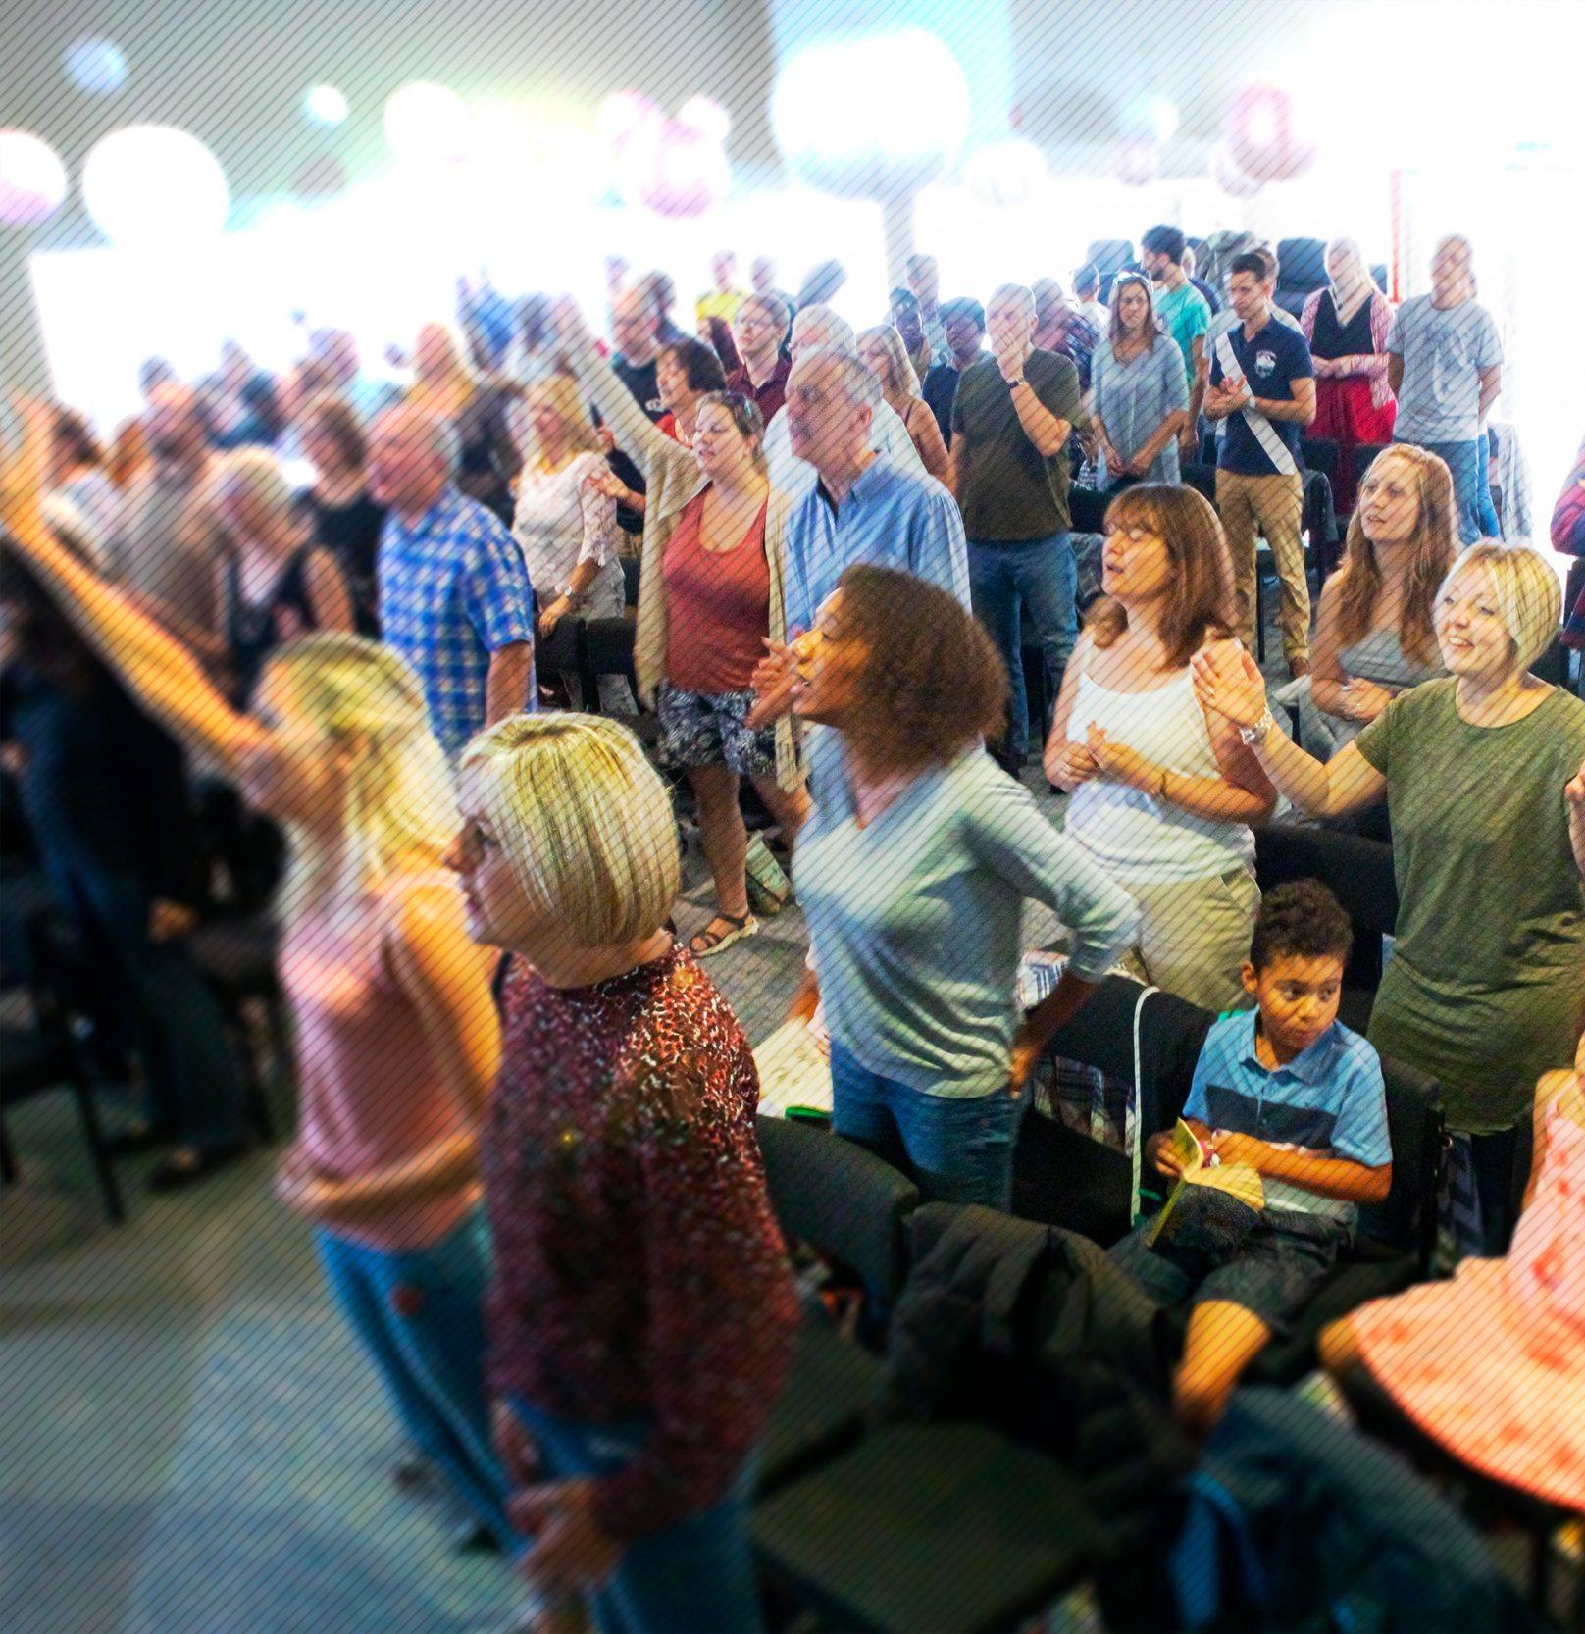
Jubilee Connects
Welcome to our virtual
Sunday gathering!
Enjoy the worship!
We’ll be starting shortly after 1030
Switch on your video so we can see you!
Please use a recognisable name onscreen.
You can send us all a message in the Chat window in Zoom but we’ve muted your voices to save background noise!

Slide 2


Slide 3

Graduation Sunday

Slide 4


Slide 5
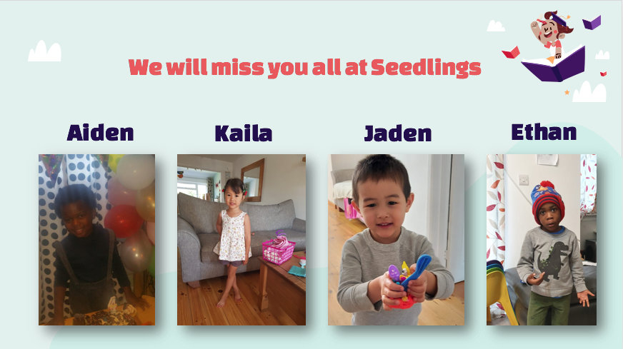

Slide 6
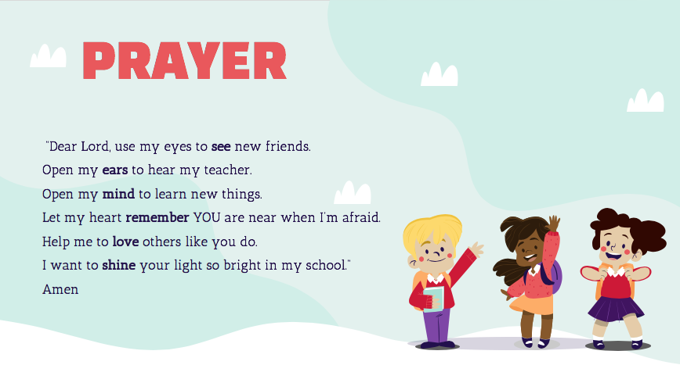

Slide 7
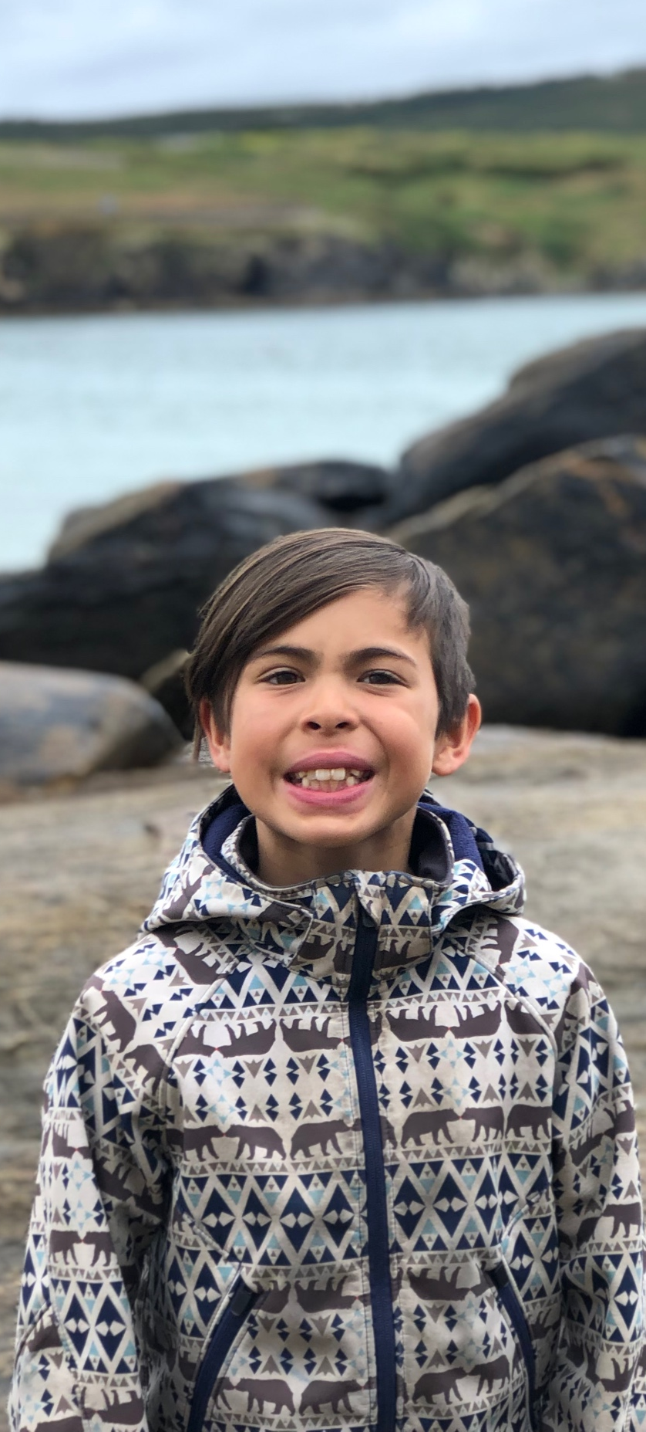

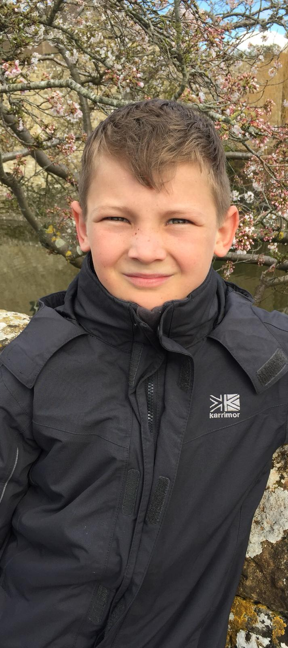
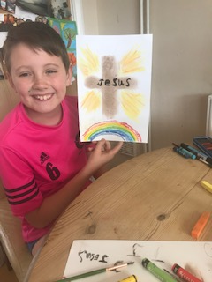
LEON
JOSEPH
MATTHEW
JONATHAN

Slide 8


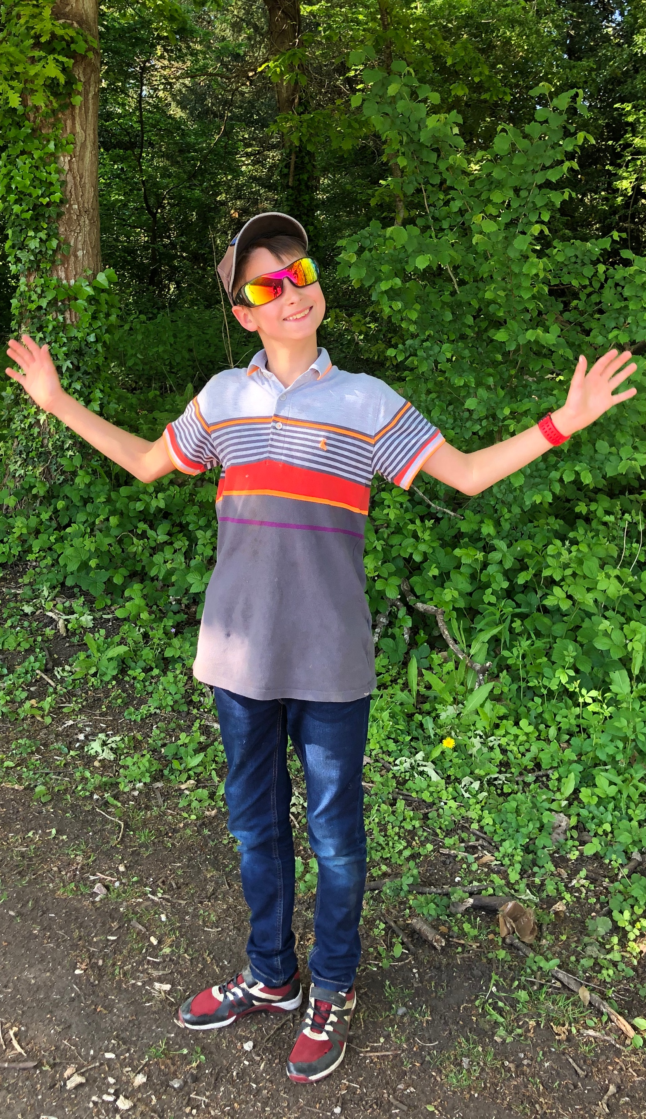
ETHAN
CHLOE
REUBEN

Slide 9


Slide 10

THE NATIONS

Slide 11

CHINA

Slide 12

UNITED KINGDOM

Slide 13
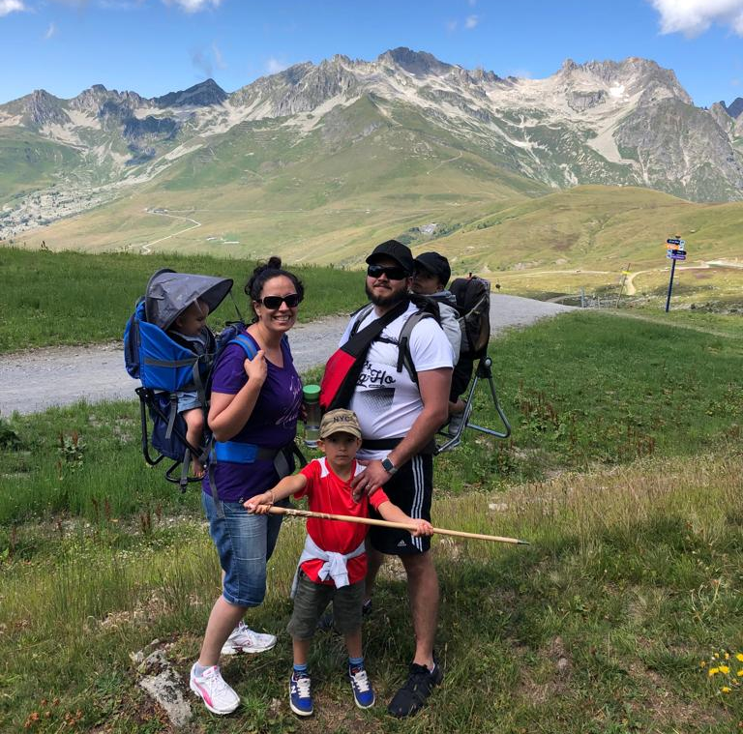
SPECIAL ANNOUNCEMENT

Slide 14

Fighting fear with faith

Slide 15


Slide 17

Announcing…

Slide 19

SEPTEMBER

Slide 20

8.00pm Tues 21st July
Single Parenting with Molly, Sophya & Debs
‘How God Feels About Single Parents’
(Zoom link sent in weekly email from Office)

Slide 21

Christianity for Beginners
Topics:
Who is God?
The Cross, the Resurrection and the Bible
What does it mean to be born again?
What are the Baptisms?
What is Prayer?
What is God’s Family?
5th August – 9th September 2020
Run on Wednesday evenings over 6 weeks.
Cost £10 for manual.
Registrations close Mon 20th July
For more info and to register contact:
Brian 07845 988 370
Ray 07711 213 293
ray.skilton@jubilee.co

Slide 22


Slide 23


Slide 25
Jubilee Connects
Goodbye! Stay safe!
Hold onto Jesus
Connect with your Home Group
Look out for your neighbours

