Slide 1
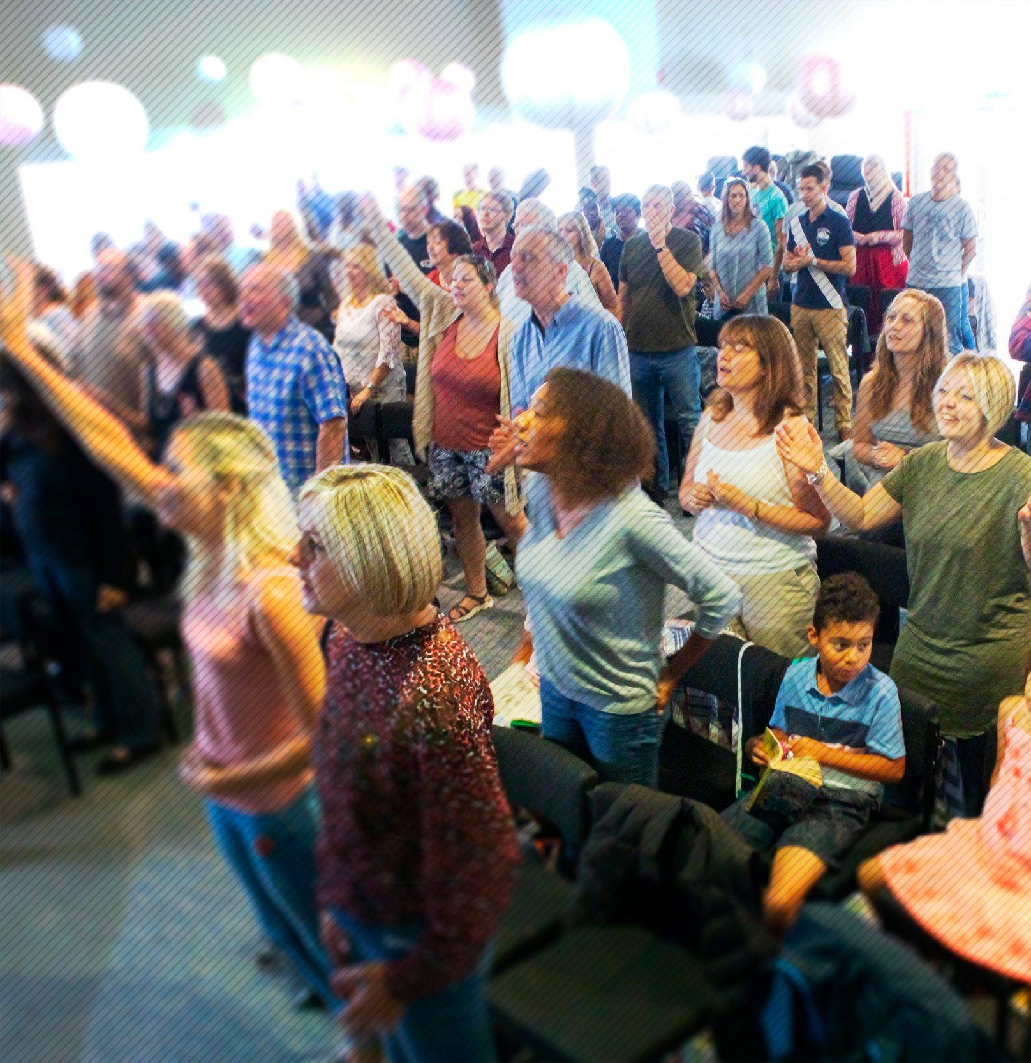
Jubilee Connects
Welcome to our virtual
Sunday gathering!
Enjoy the worship!
We’ll be starting shortly after 1030
Switch on your video so we can see you!
Please use a recognisable name onscreen.
You can send us all a message in the Chat window in Zoom but we’ve muted your voices to save background noise!

Slide 2


Slide 3

Happy Birthday!
Who has had a birthday in the last week or has one coming up?

Slide 4


Slide 5


Slide 6


Slide 7

Fighting fear with faith

Slide 8


Slide 11
JESUS
OUR REFUGE

Slide 12
PSALM 142 (NASB)
[Maskil of David, when he was in the cave. A Prayer.
I cry aloud with my voice to the LORD;
I make supplication with my voice to the LORD.
I pour out my complaint before Him;
I declare my trouble before Him.
When my spirit was overwhelmed within me,
You knew my path.

Slide 13
PSALM 142 (NASB)
In the way where I walk they have hidden a trap for me.
Look to the right and see;
for there is no one who regards me;
there is no escape for me;
no one cares for my soul.

Slide 14
PSALM 142 (NASB)
I cried out to You, O LORD;
I said, “You are my refuge,
My portion in the land of the living.
Give heed to my cry, for I am brought very low;
Deliver me from my persecutors,
For they are too strong for me.

Slide 15
PSALM 142 (NASB)
Bring my soul out of prison,
So that I may give thanks to Your name;
The righteous will surround me,
For You will deal bountifully with me.”

Slide 16
1. JESUS OUR REFUGE

Slide 17
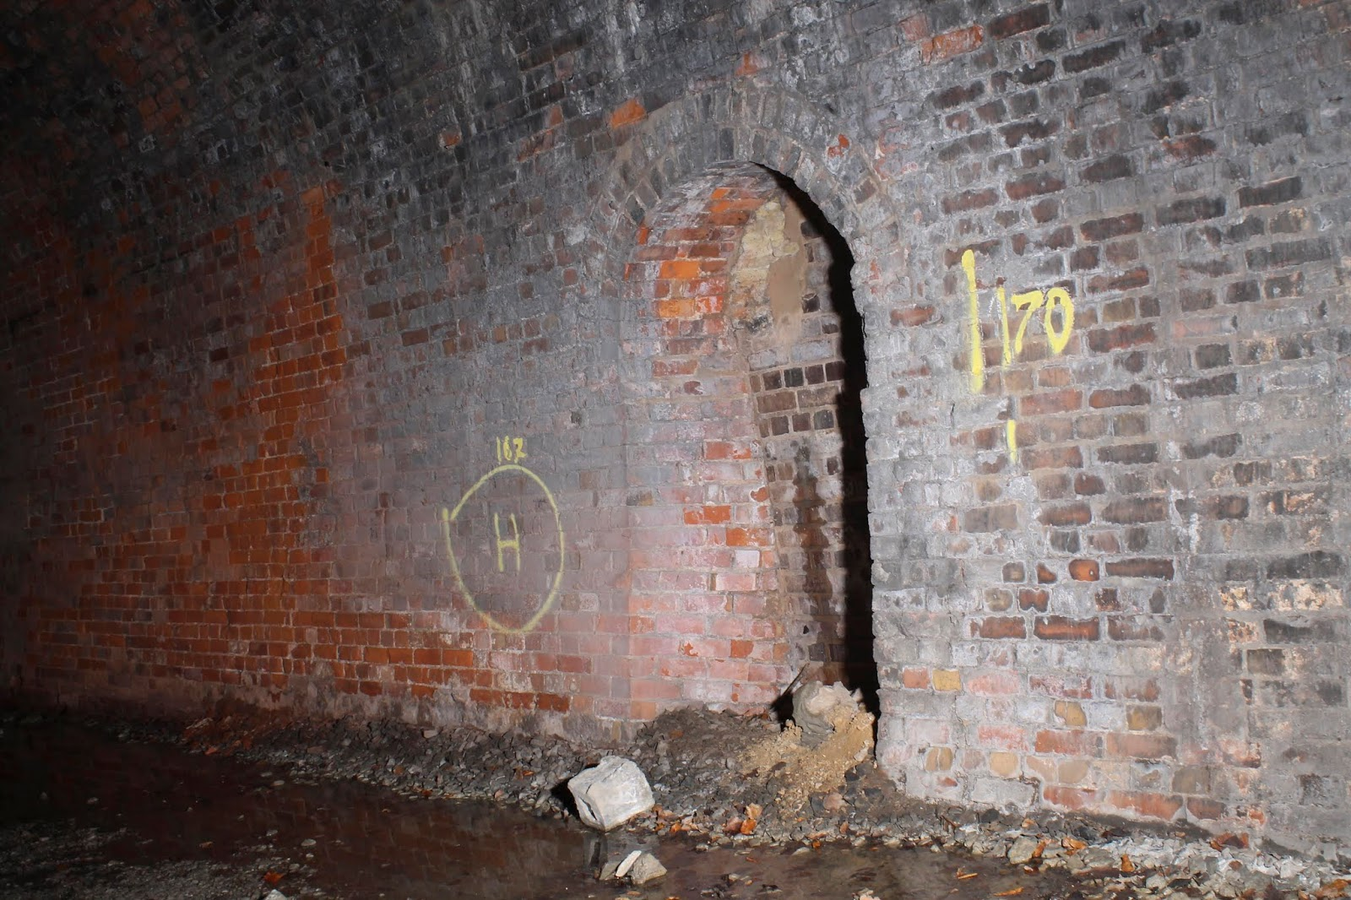

Slide 18
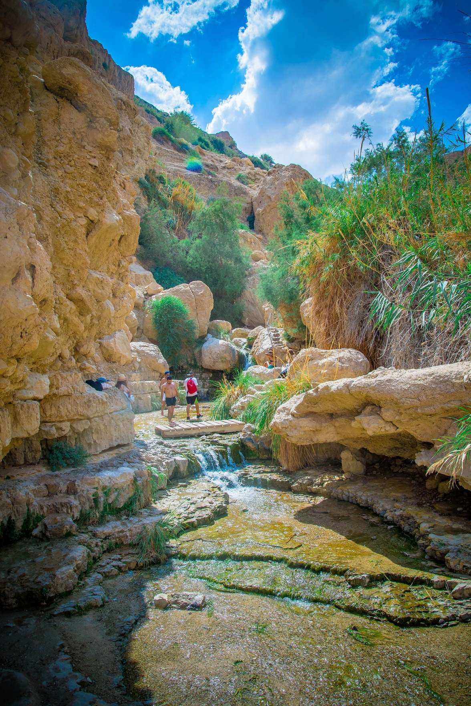

Slide 19
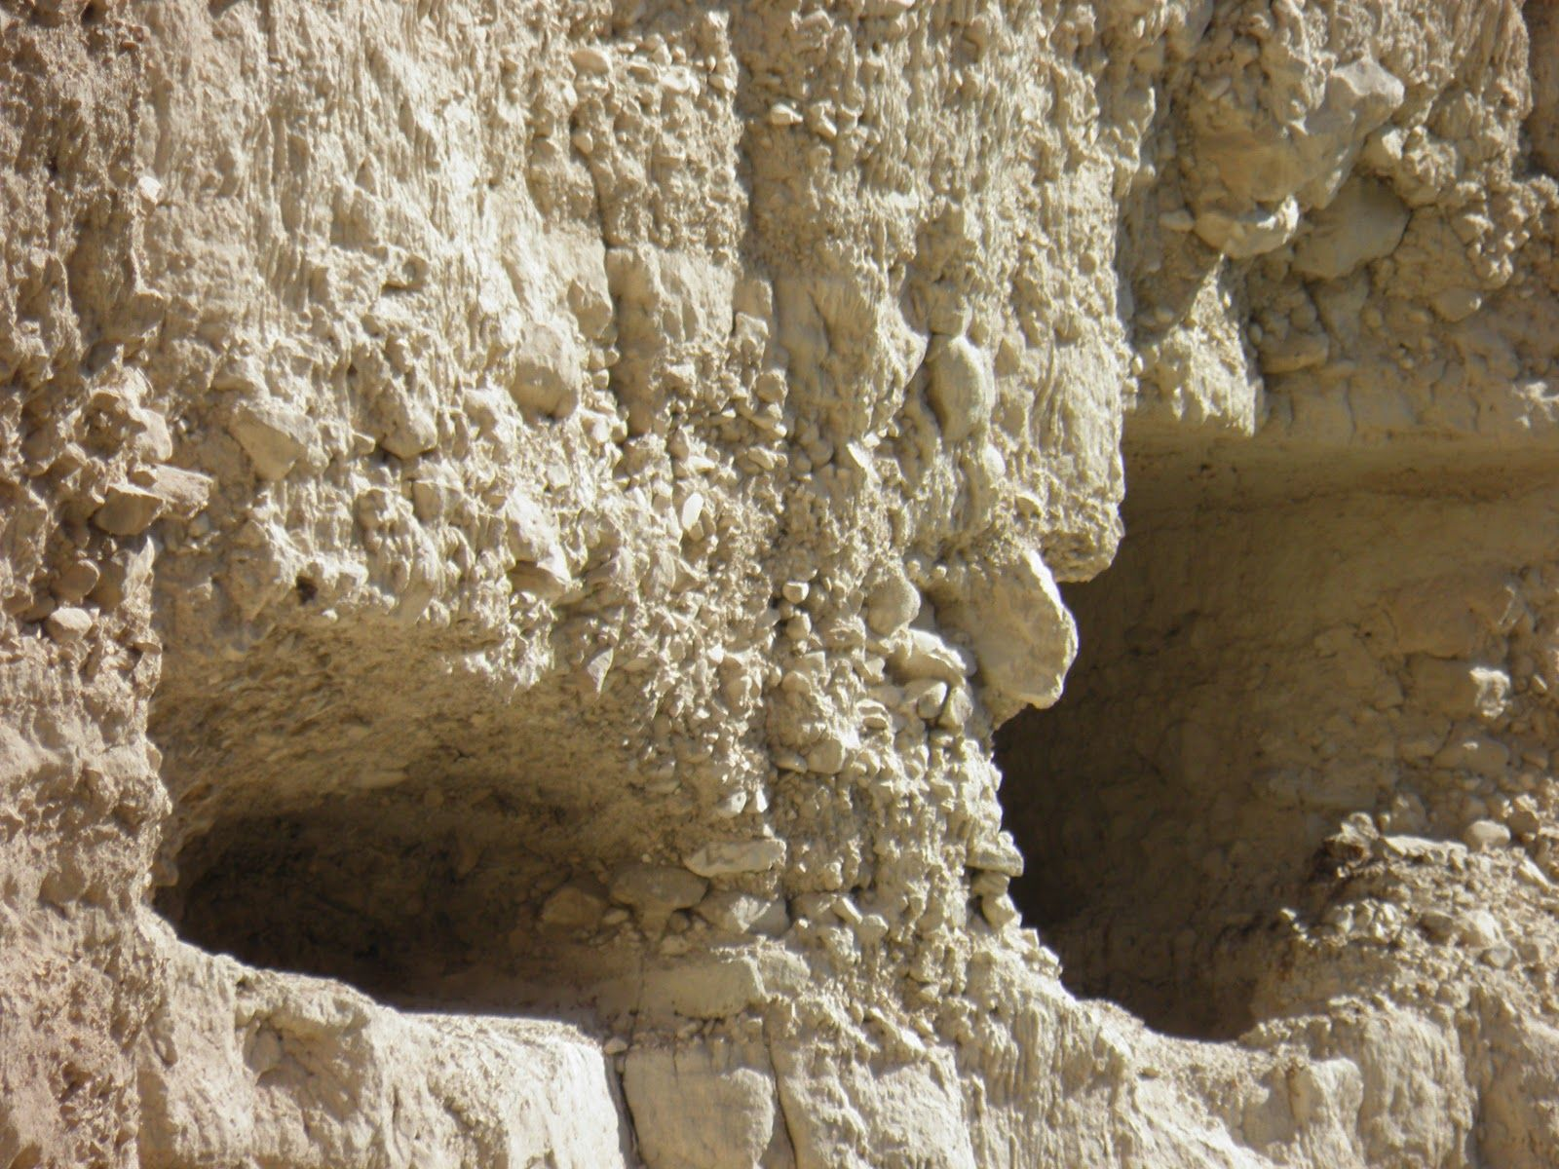

Slide 20
PSALM 142:5
“You are my refuge,
my portion in the land of the living.”

Slide 21
2. GOD’S PURPOSES ARE FULFILLED IN LOCKDOWN

Slide 22
3. DO NOT LET OUR REFUGE BECOME OUR PRISON

Slide 23
PSALM 142:7
“Bring my soul out of prison,
So that I may give thanks to Your name;
The righteous will surround me,
For You will deal bountifully with me.”

Slide 24
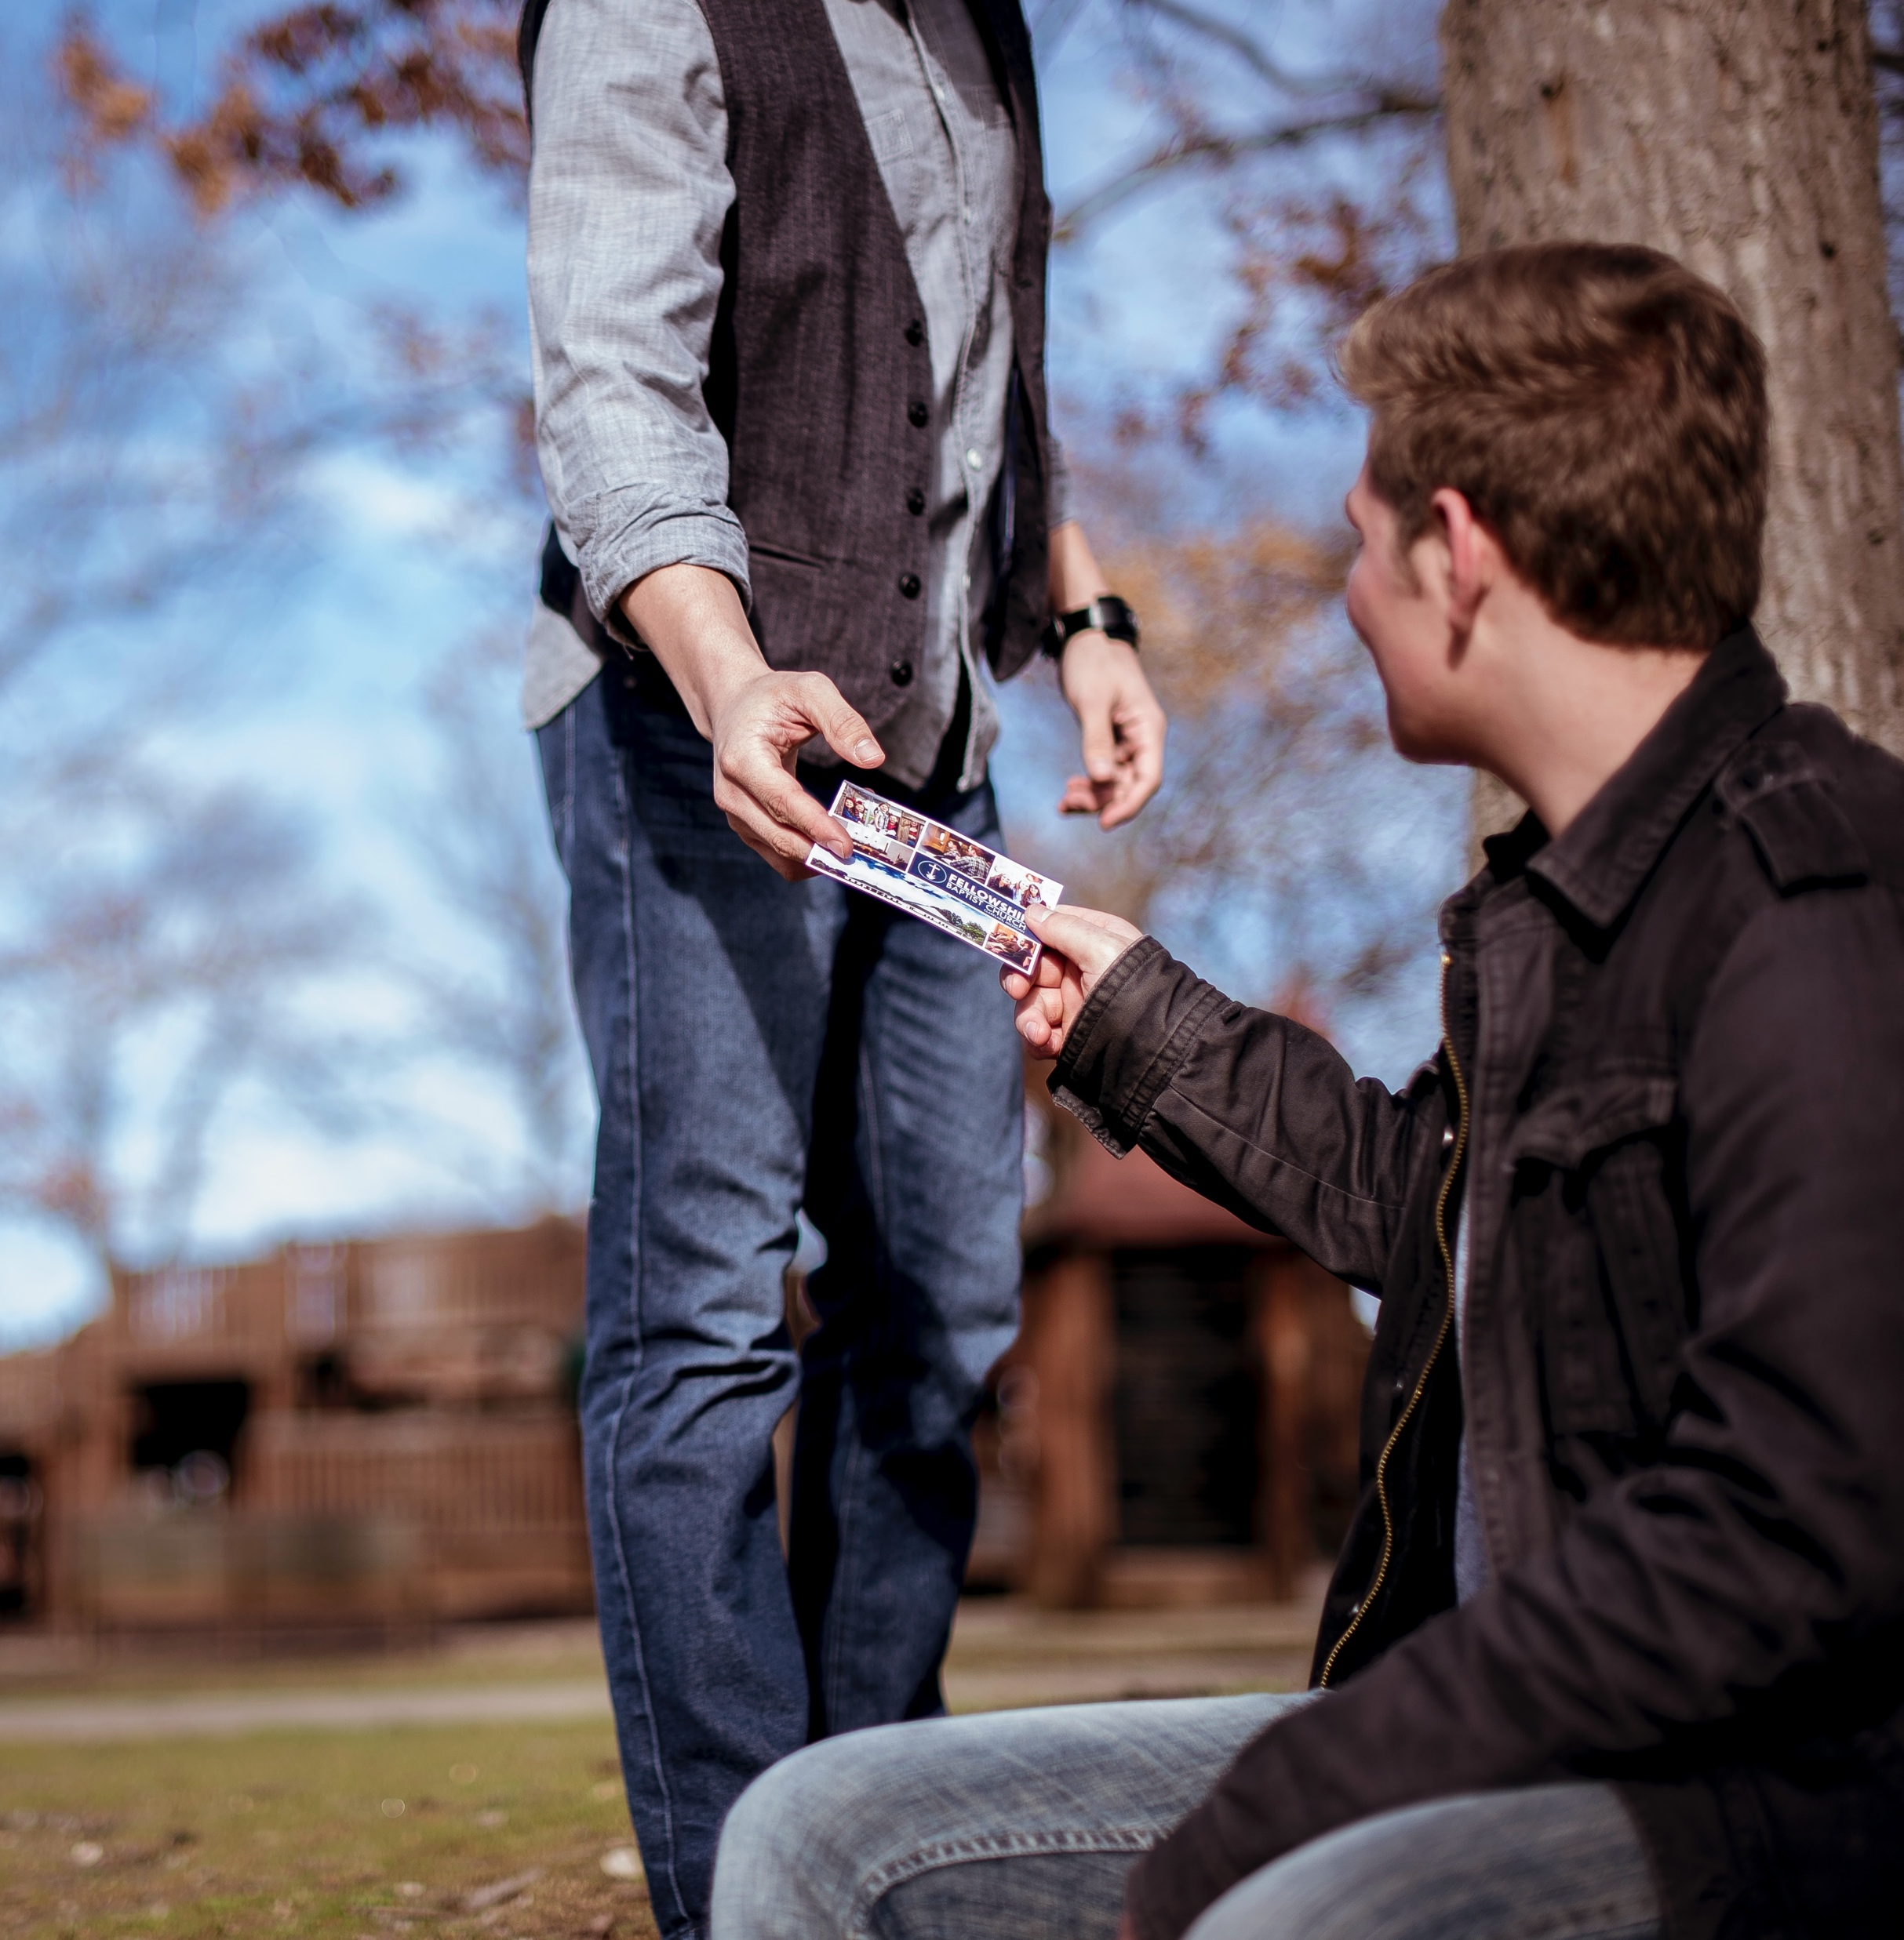
INVITATION SUNDAY
Sunday 28th June
Who could you send an invitation to?
Start praying…

Slide 25

Announcing…

Slide 26


BIBLE CHAT ROOM
What Does the Bible Say?
Hosted by Ray & Jacqui Skilton
Guest panel
Molly, Barbara B & Wanderson
Topic
The Gifts of the Holy Spirit:
Are they relevant in today’s church?
Tuesday 9th June // 11.00am
(Zoom link to come in weekly email)

Slide 27

12.30pm Thurs 11th June
‘Connectedness’ (part 2)
Hosted by Siji & Steve

Slide 28
Jubilee Connects
Goodbye! Stay safe!
Hold onto Jesus
Connect with your Home Group
Look out for your neighbours

