Slide 1
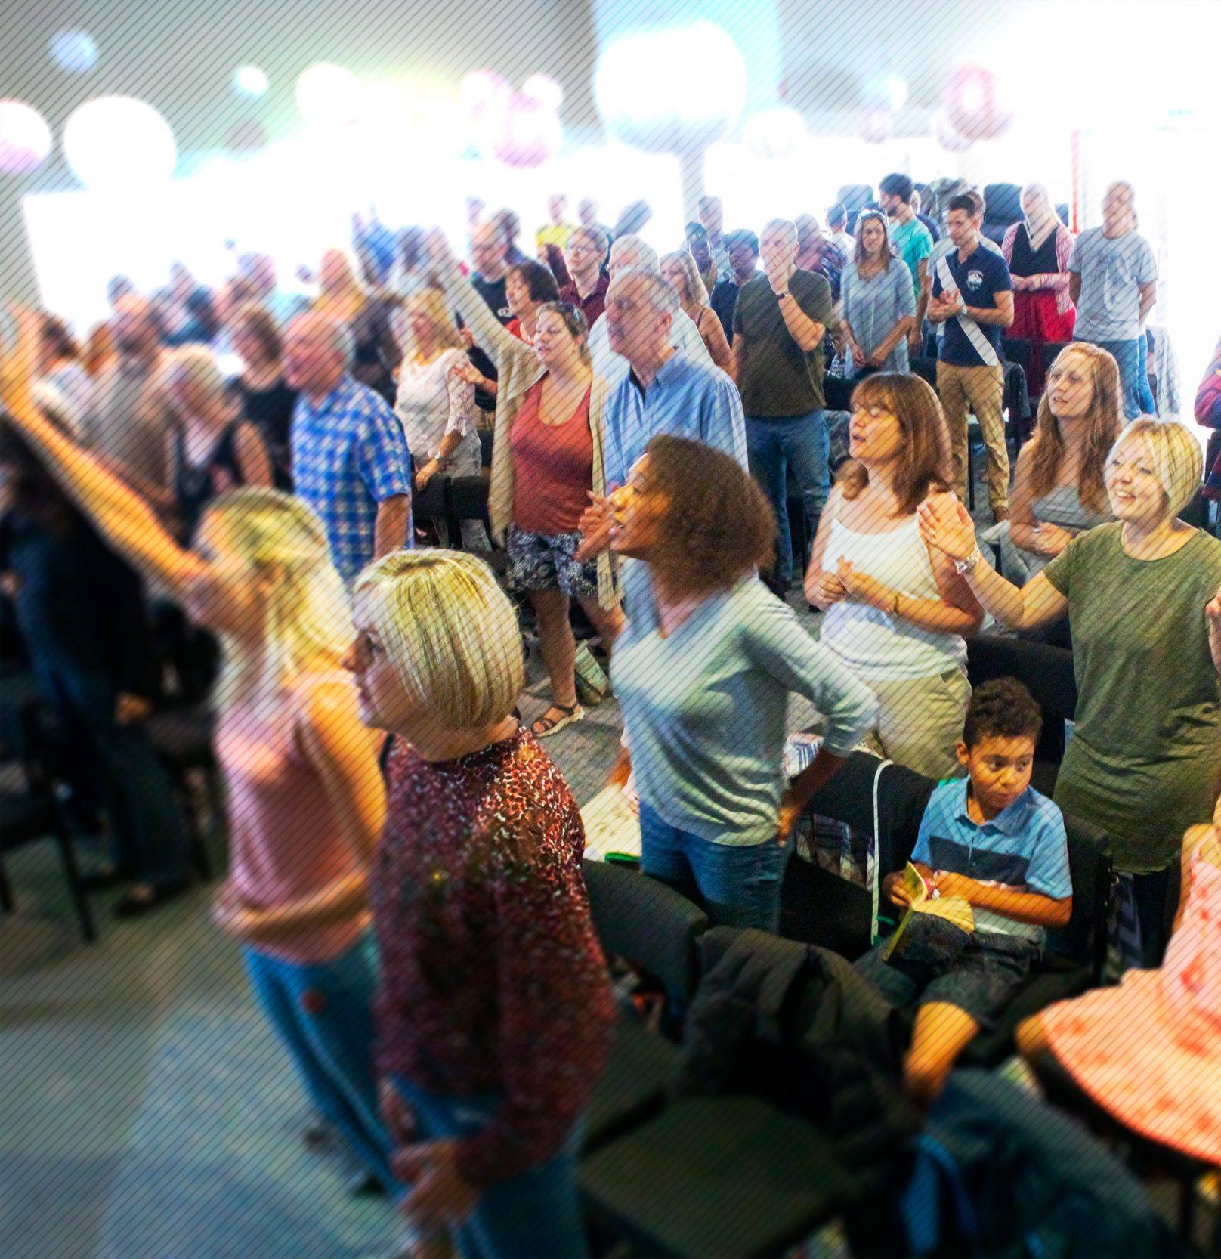
Jubilee Connects
Welcome to our virtual
Sunday gathering!
Enjoy the worship!
We’ll be starting shortly after 1030
Switch on your video so we can see you!
Please use a recognisable name onscreen.
You can send us all a message in the Chat window in Zoom but we’ve muted your voices to save background noise!

Slide 2


Slide 3
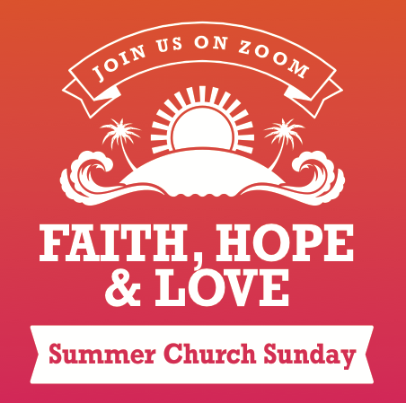

Slide 4

Happy Birthday!
Who has had a birthday in the last week or has one coming up?

Slide 5

F A I T H

Slide 7
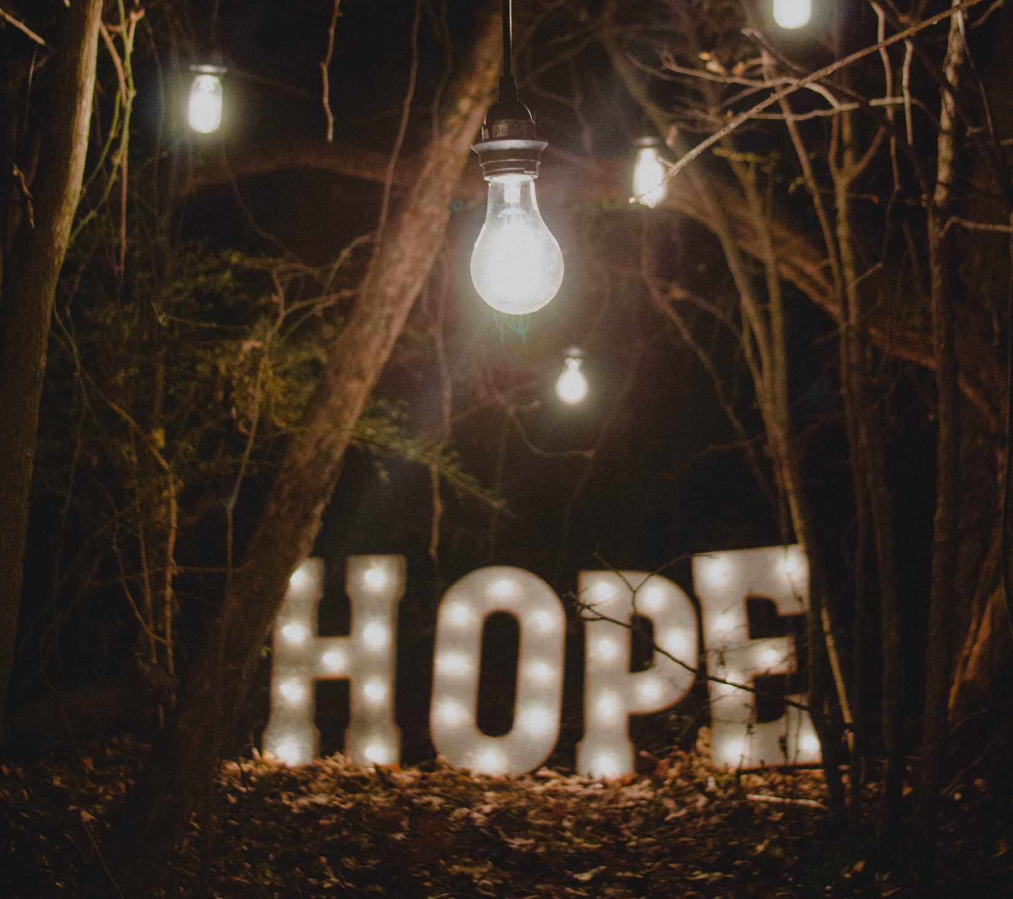

Slide 8
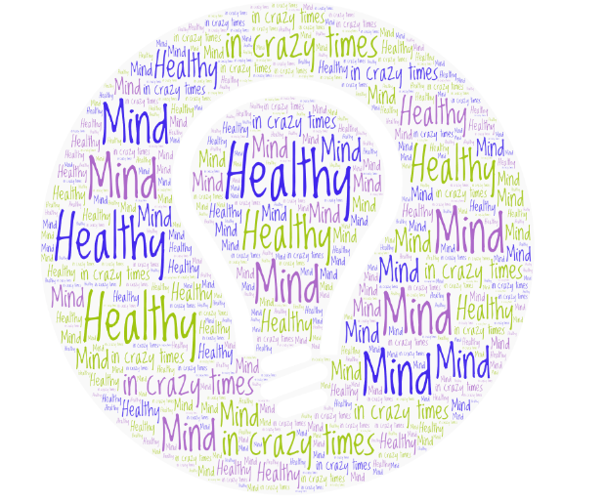
A HEALTHY MIND IN UNUSUAL TIMES
Notes:
Good morning Jubilee – I’ve got a few minutes this morning so share with you this morning on mental wellbeing. This is subject that is so relevant in our world today. Lockdown has really brought mental wellbeing to the forefront of conversations globally and as Christians we need to bold and have courage to talk about it. We all have mental health just like we have physical health, but yet there still seems to be a stigma around it. We were never made to struggle alone, to simply ‘get through life’ – we were made to live life and life abundantly. Times of mental ill health and struggles are normal – these things don’t bypass the famous, the young, the rich, the beautiful or the strong – we are all subject to times in our life were things just seem a bit much and that’s ok. So take courage today as I share with you, you are not alone!

Slide 9
3 KEYS IN
3 MINUTES
Notes:
We know that the battlefield is in our mind, so this is an area that we simply cannot neglect as we go through life. Most of know how to take care of ourselves physically, but do we give the same care and attention to our minds and keeping it healthy.
Now some of you may be thinking, well some people are just born happier and more content than others – well, ladies and gentleman, that is not entirely true. Look at the the diagram on your screen right now. This research looks at the things that influence our happiness and these are the conclusions - 50% of it is a genetic setpoint, 10% of it is ‘life’ (there is a global pandemic, these are uncertain times, this is a legitimate issue); but a whopping 40% is down to our actions and thoughts – our habits and behaviour is under out control.
We CAN therefore work on increasing happiness and overall wellbeing, but we must focus on the correct things – the things we can control – our thoughts and actions. Now I don’t have time to go through all the theories on controlling your thoughts, but I am sure you know how powerful (both good and bad) these can be for us. But that’s a discussion for another day.
So in our short time together today, I am going to give you three keys in three minutes. But more than that, I am going to impart knowledge today, and if you chose to take action, this has the potential to really change your situation! Sound ok to everyone …… great, that’s the right answer!

Slide 10
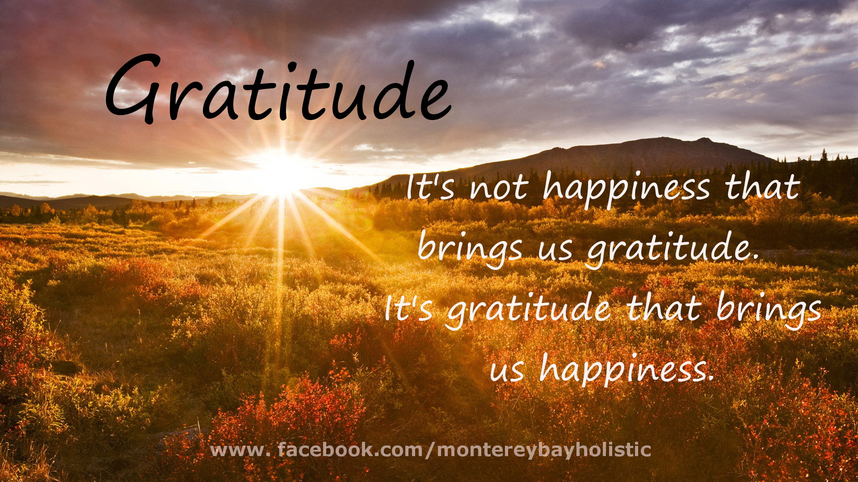
Notes:
The first key is GRATITIDE. A concept that you will no doubt already be aware of, but what I am going to challenge you with today is to make it a purposeful practice in your daily life. Gratitude has the wonderful power to take my mind off myself and my situations and shift my focus to the blessings in my life.
It will not be news to you that gratitude, as a genuine practice, leads to a very powerful increase in psychological wellbeing. I often open my meetings and conferences at work by asking people to introduce themselves and tell us about one thing that they are genuinely grateful for. A simple act, but one that is profoundly significant to help change atmosphere and in sharing gratitude with each other, we inadvertently drive social connection which is key to wellbeing.
I do not have time this morning to share all the science and theory behind the correlation between gratitude and cognitive wellbeing, but I want to very quickly share some scientific benefits of gratitude:
Gratitude opens the door to more relationships.
Gratitude improves physical health. Grateful people experience fewer aches and pains. Not surprisingly, grateful people are also more likely to take care of their health. They exercise more often and are more likely to attend regular check-ups with their doctors, which is likely to contribute to further longevity.
3. Gratitude improves psychological health. Gratitude reduces a multitude of toxic emotions, ranging from envy and resentment to frustration and regret.
4. Gratitude enhances empathy and reduces aggression.
5. Grateful people sleep better. Writing in a gratitude journal improves sleep, according to a study published in Applied Psychology: spending just 15 minutes jotting down a few grateful sentiments before bed, can help you sleep better and longer.
6. Gratitude improves self-esteem. Studies have shown that gratitude reduces social comparisons. Rather than becoming resentful toward people who have more money or better jobs – which is a major factor in reduced self-esteem- grateful people are able to appreciate other people’s accomplishments.
7. Gratitude increases mental strength. For years, research has shown gratitude not only reduces stress, but it may also play a major role in overcoming trauma. Recognising all you have to be thankful for – even during the worst times of your life – fosters resilience.
So perhaps today, you can think abut someone that you would like to thank .,… don’t just think about it guys, take action. And here’s another challenge, do you really count your blessings – I mean really count them. What if you sat down this afternoon and took a few moment to count them …. I bet you would have more than you originally thought and I guarantee, that as you purposefully do this, you will start to feel different.

Slide 11
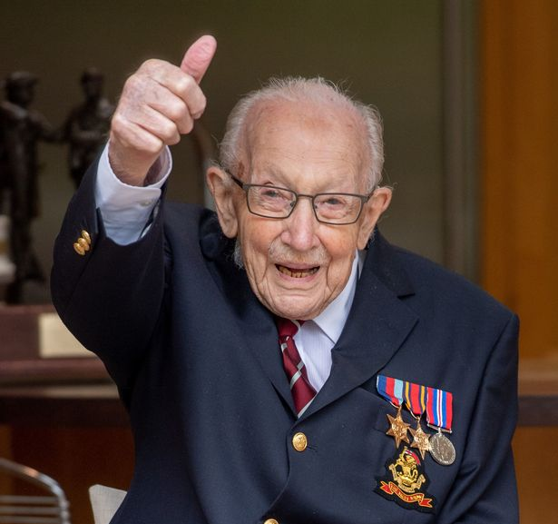
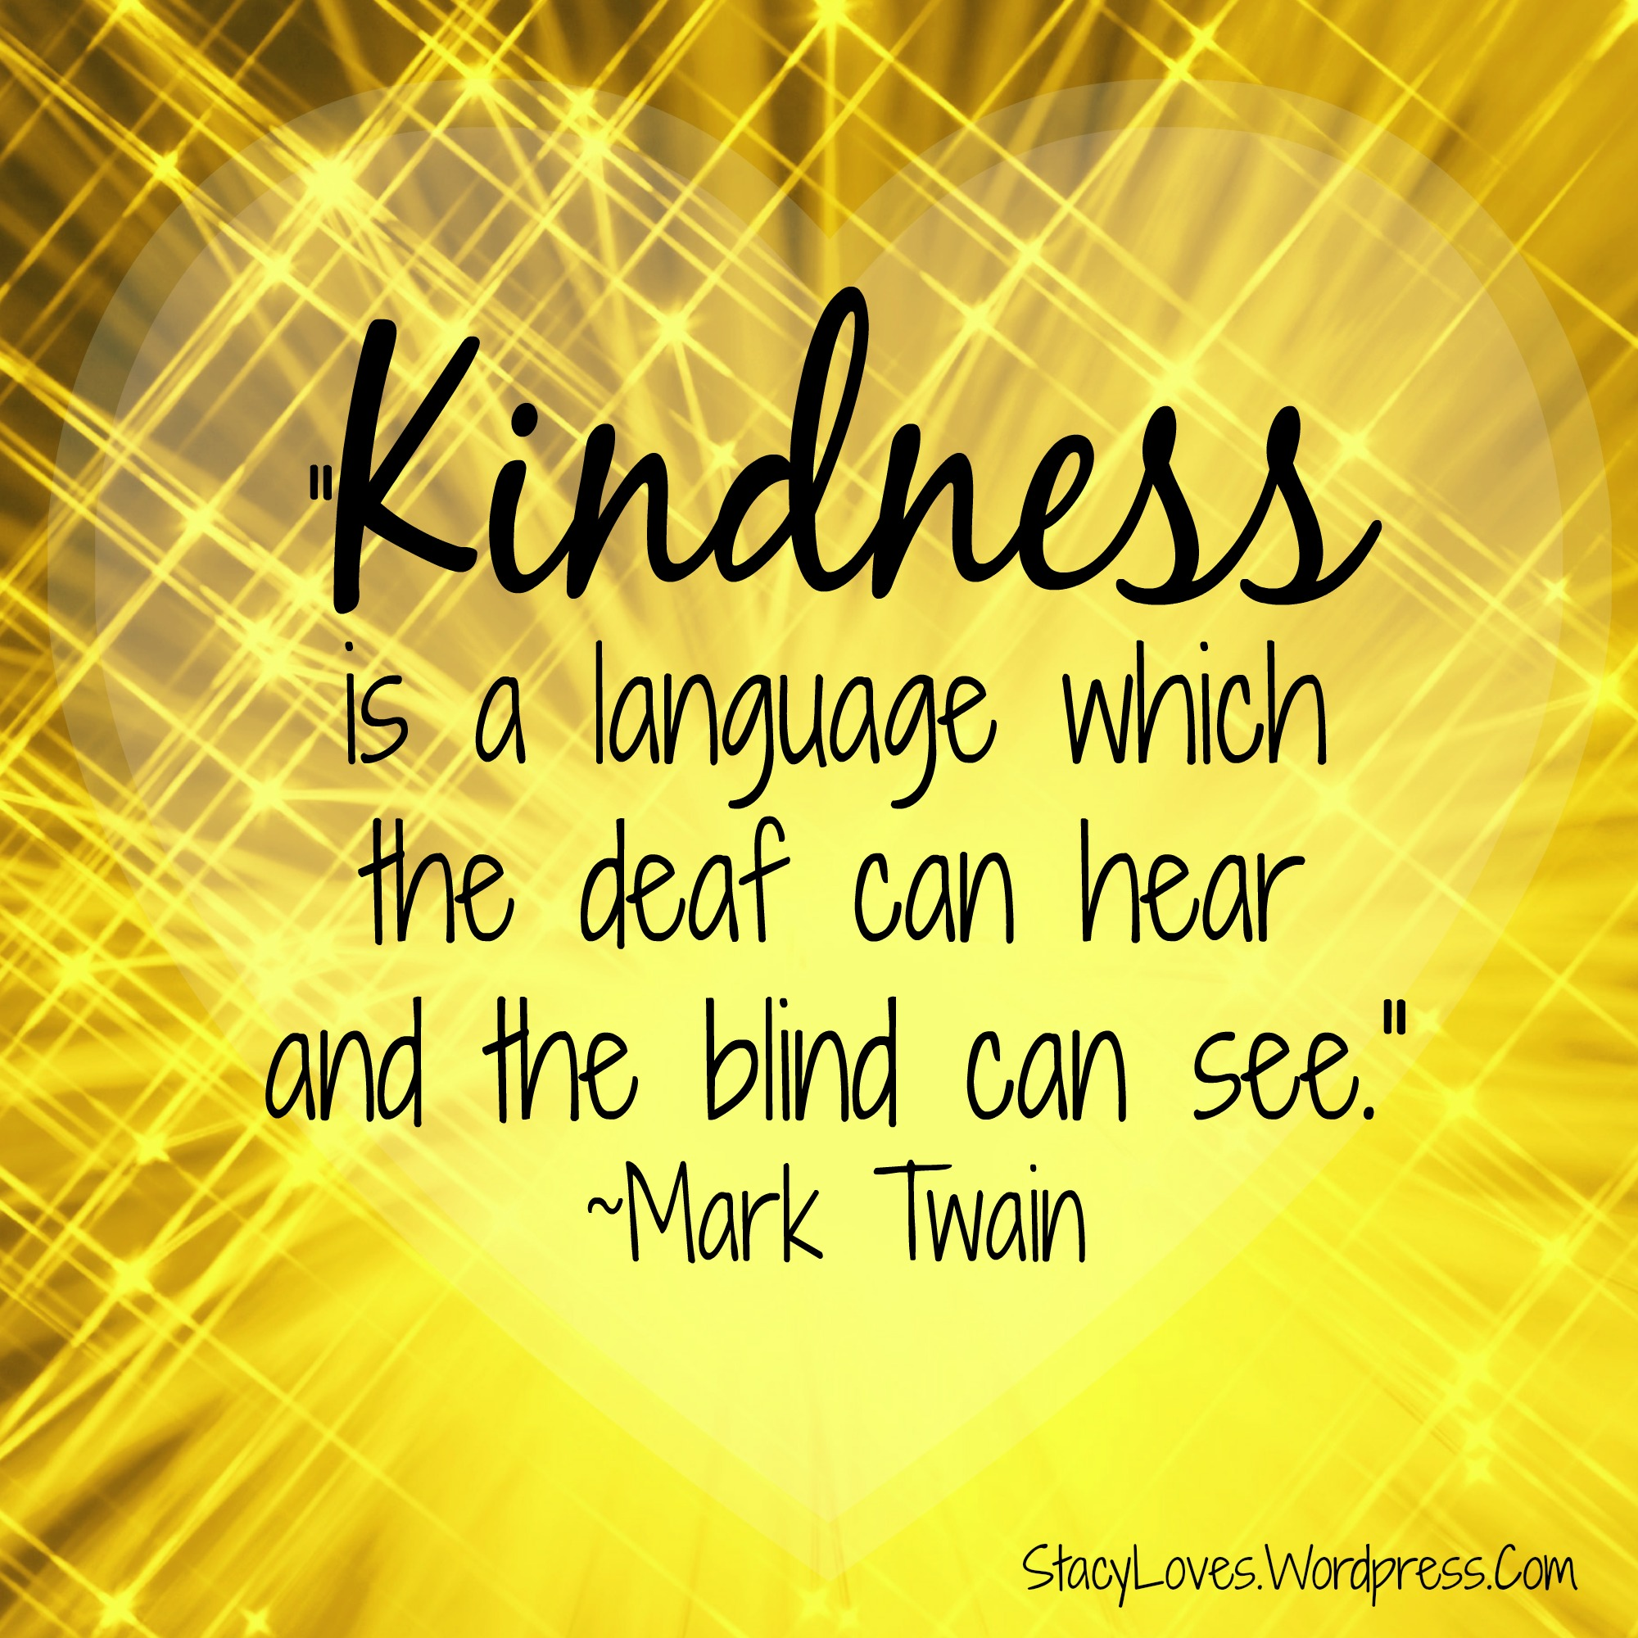
KINDNESS
Notes:
The second key is KINDNESS.
Kindness is flourishing in the world we live it – especially during the lockdown I have seen so much of it around me. No doubt you have seen local examples of people reaching out, doing both small and big things to show kindness to others.
We have seen it in the dancing eyes of 100-year-old Captain Tom Moore as he walked his garden to raise money for the NHS and in the numerous community aid groups responding to local needs.
There are 2 elements to kindness I want us to focus on:
Firstly – kindness to yourself, selfcare is not selfish, it is key to enabling you to be the best version of yourself! You need to make time to be kind to yourself (this will look different for each of us, but its about finding something that brings us joy and helps recharge our batteries). And what about that internal dialog. Now don’t sit there and pretend you don’t have one – we all do – yes, even Neil has one! Do you speak to yourself as kindly as you do to others, do you treat yourself with grace and acceptance in the same way you extend this to others? You will never speak to someone as much as you talk to yourself in your head, so chose your words carefully – be kind.
The second part of kindness is – kindness to others. The impact on the person giving the kindness is immense and we all need to strive to purposefully live our lives in kindness. The good news is that kindness is alive and well today, especially during lockdown.
Kindness is a superpower that we can engage. Research shows us that it can hep increase our physical and physiological wellbeing – kindness helps us produce Oxytocin, which is the cardio-protective hormone, which protects the heart by lowering blood pressure, oxytocin also reduces the free radicals and inflammation which are know to speed the aging process and acts of kindness are also linked to our collective survival. From a phycological point of view it increases our sense of belonging, increases our confidence and helps us keep things in perspective. It creates positive memories that we can draw on in the future.
So kindness, ladies and gentleman is the 2nd key that can genuinely increase our mental wellbeing and happiness.

Slide 12
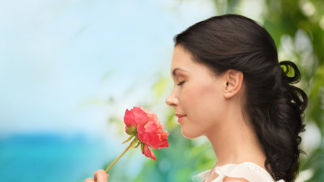
SAVOURING
Notes:
The third and final key is SAVOURING - So lets look at Savouring, what is this?
Savouring = the act of stepping aside of an experience to review and appreciate it. Its about being mindful and having a moment of realisation
Sometimes this act will come naturally, other times you will need to be purposeful to find moments to savour in every day. Lets look at some of the benefits to our happiness and wellbeing ….
It forces us to actually notice and enjoy.
It forces us to shift our attention
If focusses our mind on the experience and as a result we enjoy the experience for longer.
The great thing about savouring of course, is that it also benefits others, do you know what I mean …. If you have truly savoured a moment, you will look for someone to tell about it – you’ll share the experience with them, therefore brining yourself happiness all over again and with some luck, you’ll even put a smile on their face. So suddenly it has a wider much ‘reach’.
And here's another fabulous thing about savouring ….. You can actually push ‘play’ in your mind and visualise and relive the moment again and again and again.…. So take a moment now to perhaps think about something that you could replay in your mind……….Something this past week that brought you happiness, something that you really savoured……… You will find the practice of savouring is very, very powerful and you’ll understand why its truly a superpower and key to mental wellbeing.

Slide 13
Take time to be KIND to YOURSELF and OTHERS
SAVOUR the moment
Purposefully practice GRATITUDE
Summary of the 3 KEYS
Notes:
So a quick summary …..
All of the keys we have spoken about today can be put into practice, like a physical muscle you will need to purposefully exercise them in order to see growth and strength. We’ve discussed the misconception that some people are just born happier than others – we all have mental as well as physical health and we need to learn to take care of our mental health in a purposeful and productive way.
Firstly - Practice gratitude – make this a lifestyle choice. We know it has long terms positive effects on our personal wellbeing and causes us to focus on the things we have in life rather than the things that are missing.
Take time out to be kind to others and to yourself – watch your words and your internal dialog Only you will know when you need time out – but don’t ignore the signs, self care is not selfish!
Savour the moment – truly enjoy it – be fully present – this has lasting effects and remember that you can REPLAY this moments afterwards and share them with friends

Slide 14
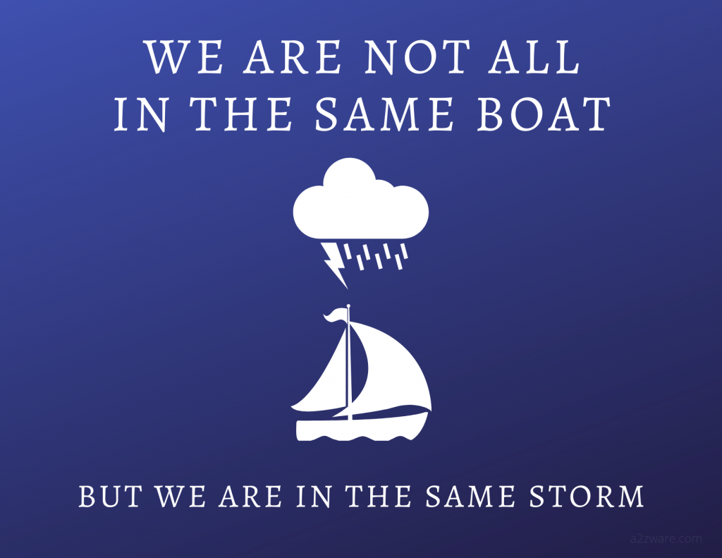
BLESSING AND CALL TO ACTION
Notes:
In conclusion, a common misconception is that KNOWING is half the battle – knowing about something without action is fruitless. Today as you have heard me speak on these 3 keys, you need to determine in your heart to take action or nothing will change in your life! You need to do something with the knowledge you have gained.
So to end out session I want to pray a prayer of blessing over you and the households that you represent today, so lets pause for a moment and let me pray with you.
Lord, I thank you for blessing us with this time together today, thank you that we have been able to briefly ponder mental wellbeing together. Thank you that your name is above our struggles – thank you that you are patient and kind toward sus that you understand challenges we face and those moments in our lives where things seem overwhelming. You sit on your throne, high above the battles we face today and tomorrow and the day after – you are above depression, loneliness, anxiety and fear. You peruse us and have destined us to walk boldly in power, in love and with a sound mind! Your will is that we have healthy minds and that we can experience joy, happiness and peace in our lives. Thank you that we dwell within the shelter of the most high, that we abide in the shadow of the almighty and that your desire is that we walk in freedom. Truly we cannot comprehend the breadth and length, the high and depth of your love for us. Your have planned a future for us and you have given us hope. Today may we not only be moved by what we have discussed together, but may we commit to change, to implement these keys in order to walk in freedom. Father, you know our hearts, our thoughts the things that plague our mind and you know them because you experienced them too – so Father, today and bring freedom in the area of our mental wellbeing, be the light in our darkness. In Jesus name, Amen.

Slide 16


Slide 17
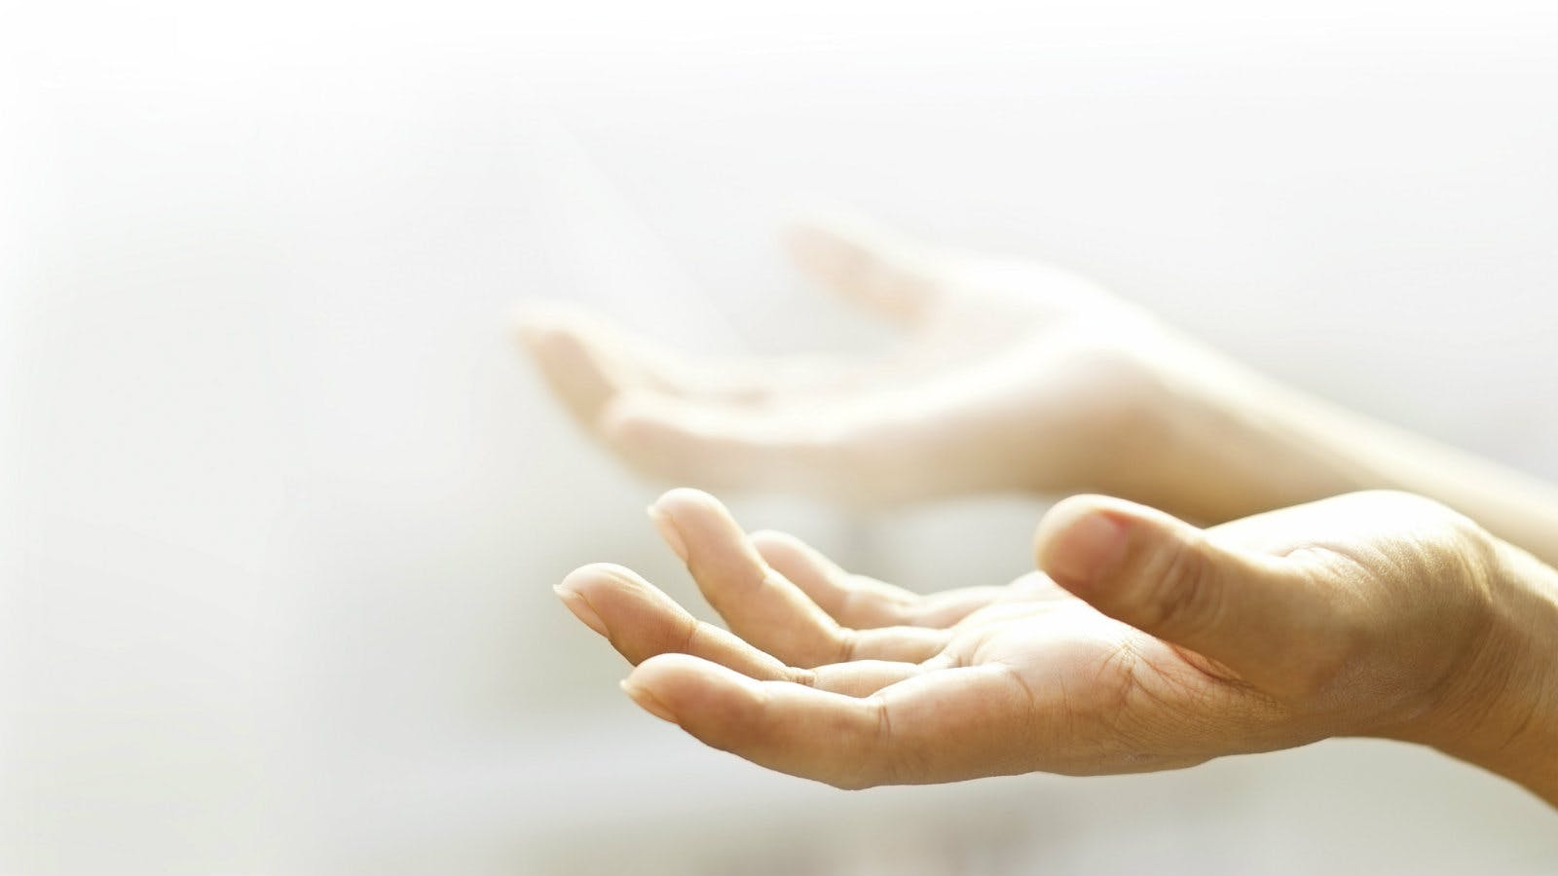
Fighting fear with faith

Slide 18


Slide 19

JOHN’S STORY

Slide 21

Announcing…

Slide 22
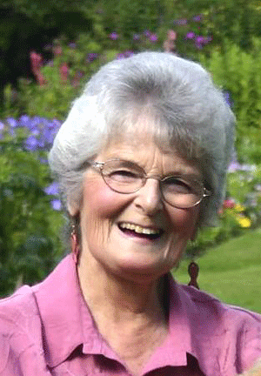
An Interview with
Jennifer Rees Larcombe
7.30pm Tuesday 30th June
Hosted by Molly
Zoom link available by contacting Molly or office@jubilee.co
To learn more about Jennifer go to: www.beautyfromashes.co.uk

Slide 23

Rutland Woods
Work Party
Saturday 4th July
9am – 1pm
Interested in joining?
Contact Tim Biddlecombe by phone or email
tim.biddlecombe@jubilee.co

Slide 24
Alpha Course
Starting week beginning 6th July
Runs for 10 weeks
For more information or to sign up, contact:
Emma Wilson
office@jubilee.co

Slide 26
Jubilee Connects
Goodbye! Stay safe!
Hold onto Jesus
Connect with your Home Group
Look out for your neighbours

