Slide 1
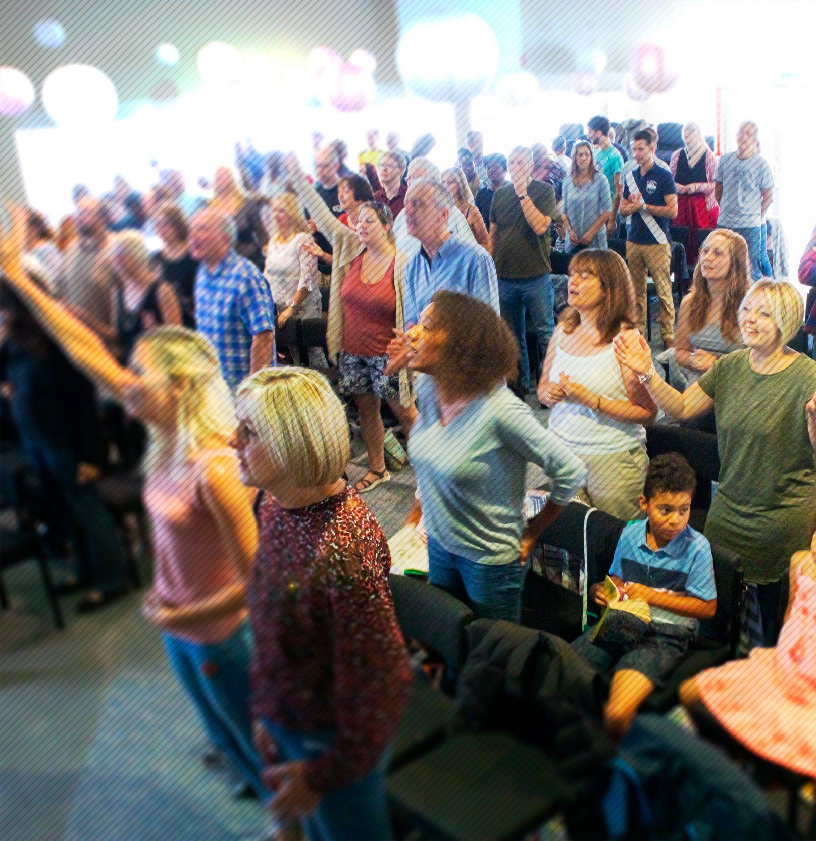
Jubilee Connects
Welcome to our virtual
Sunday gathering!
Enjoy the worship!
We’ll be starting shortly after 1030
Switch on your video so we can see you!
Please use a recognisable name onscreen.
You can send us all a message in the Chat window in Zoom but we’ve muted your voices to save background noise!

Slide 2


Slide 3
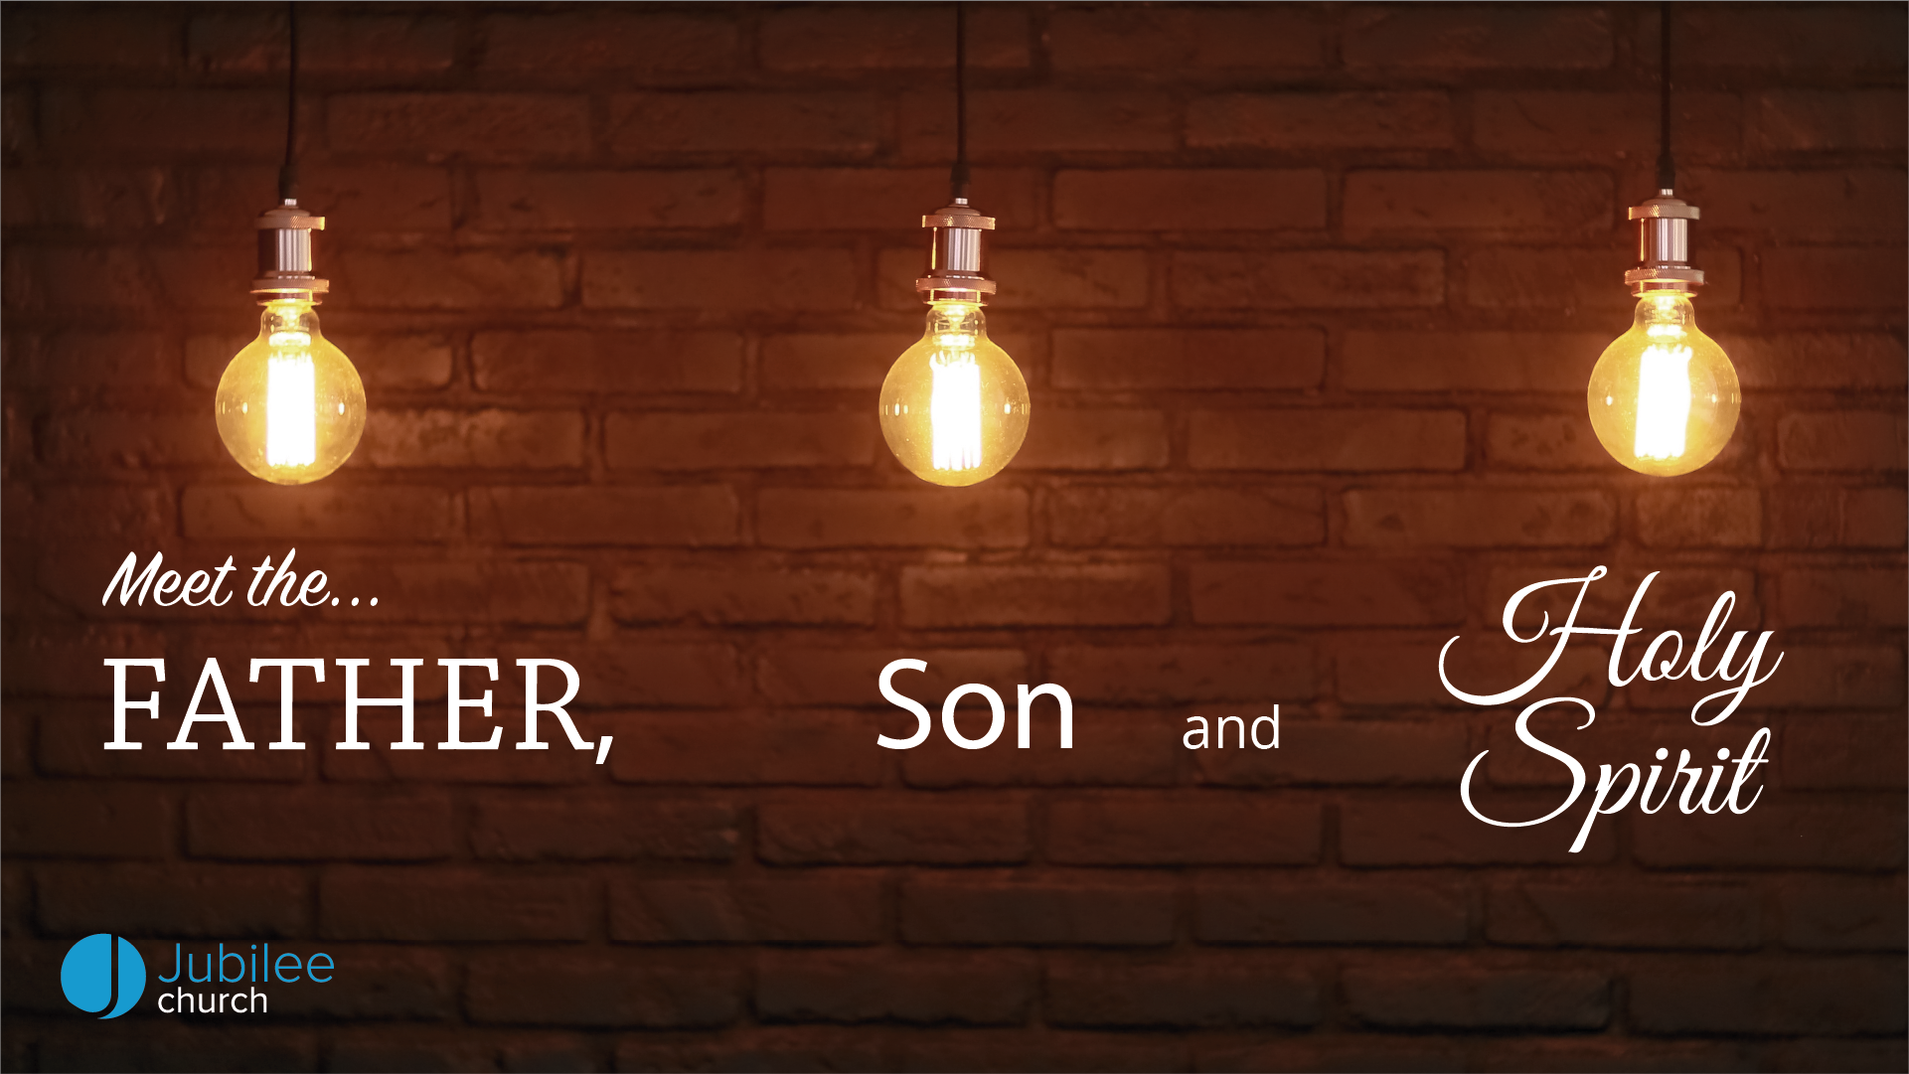

Slide 4


Slide 5
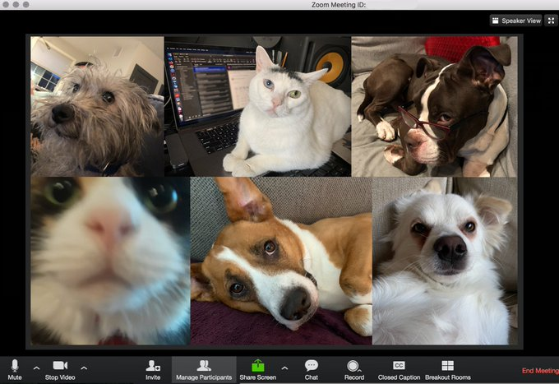

Slide 6

Announcing…

Slide 7
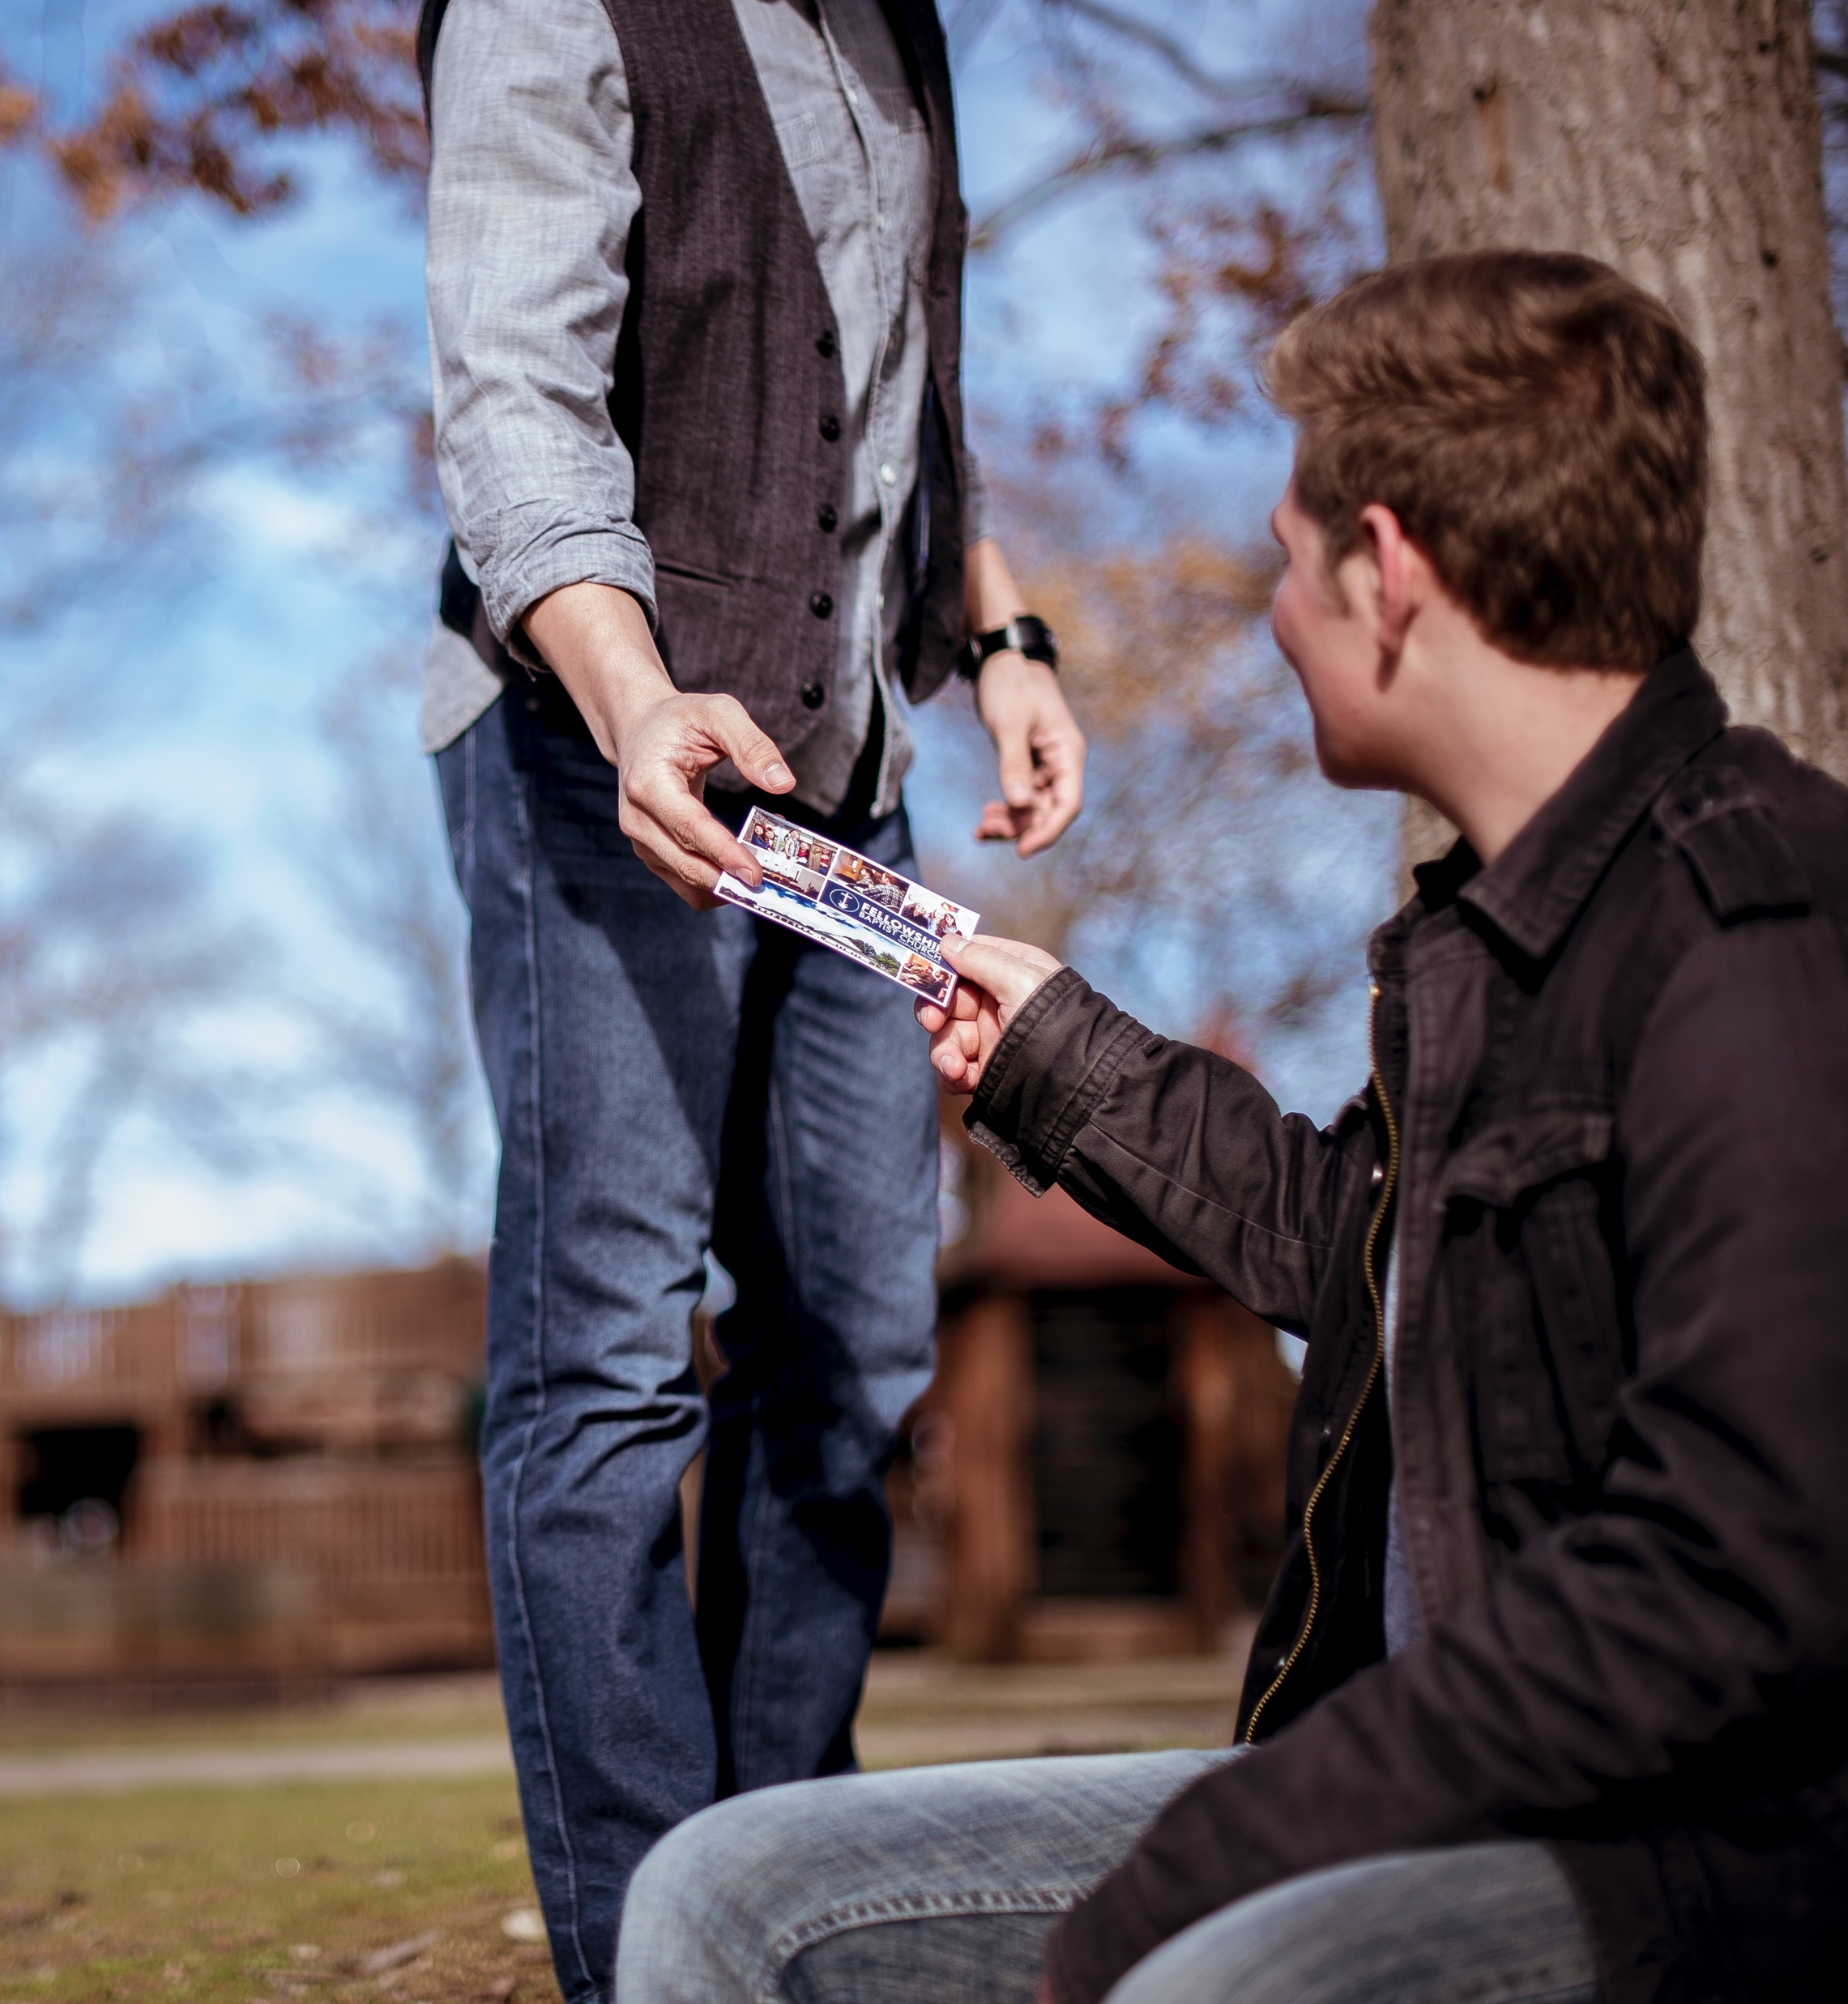
Invitation Sunday
Celebration on Zoom
Sunday 28th June
10.30am
Who could you send an invitation to?
Start praying…

Slide 8

Donation of children’s clothing (6 months to 5 years) and any unopened packs of nappies, wipes and formula.
Open Wednesday mornings // 10am – 12pm
Park Wood Hub
Behind Christ Church building on Wallis Ave, ME15 9JW
For more info email: princessproject@hotmail.co.uk

Slide 9
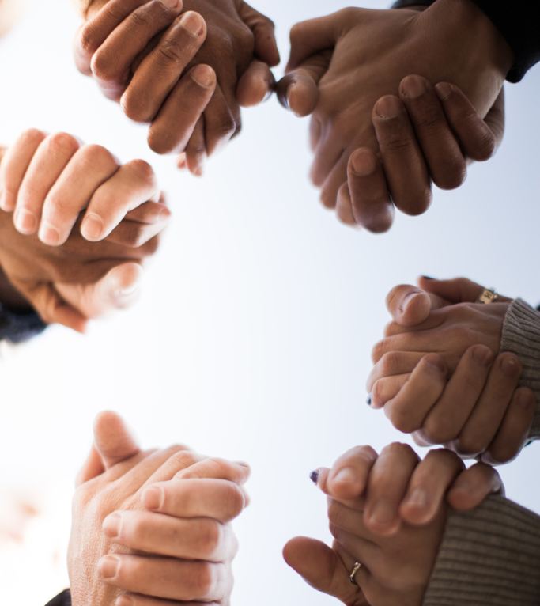
Prayer Power Hour
Wednesday 17th June
7.30 – 8.30pm
On Zoom
(Zoom link in weekly email)

Slide 10

12.30pm Thurs 18th June
‘Living Free from Burdens’
Hosted by Kim & Emma
(Zoom link in weekly email)

Slide 12
#listentomystory

Slide 13
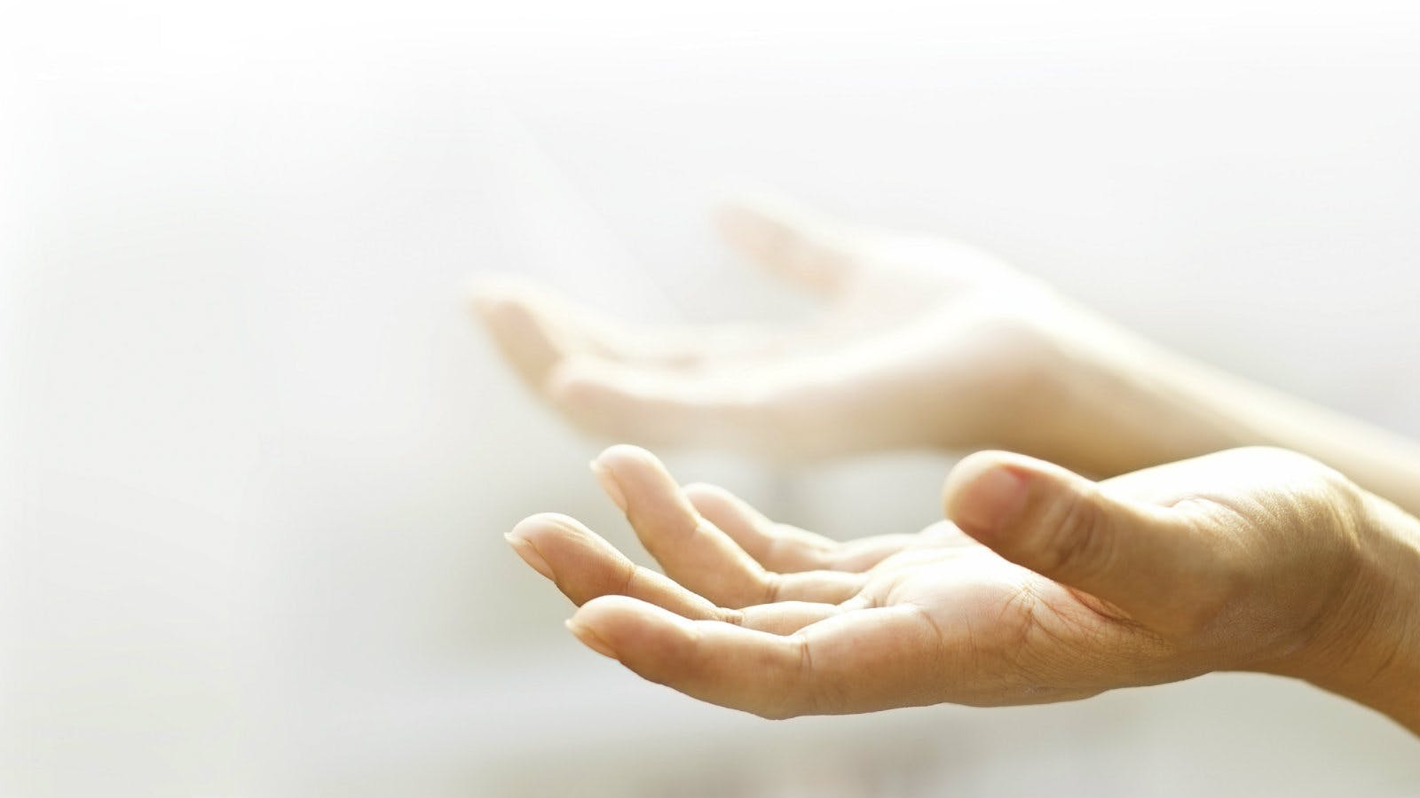
Fighting fear with faith

Slide 14


Slide 16
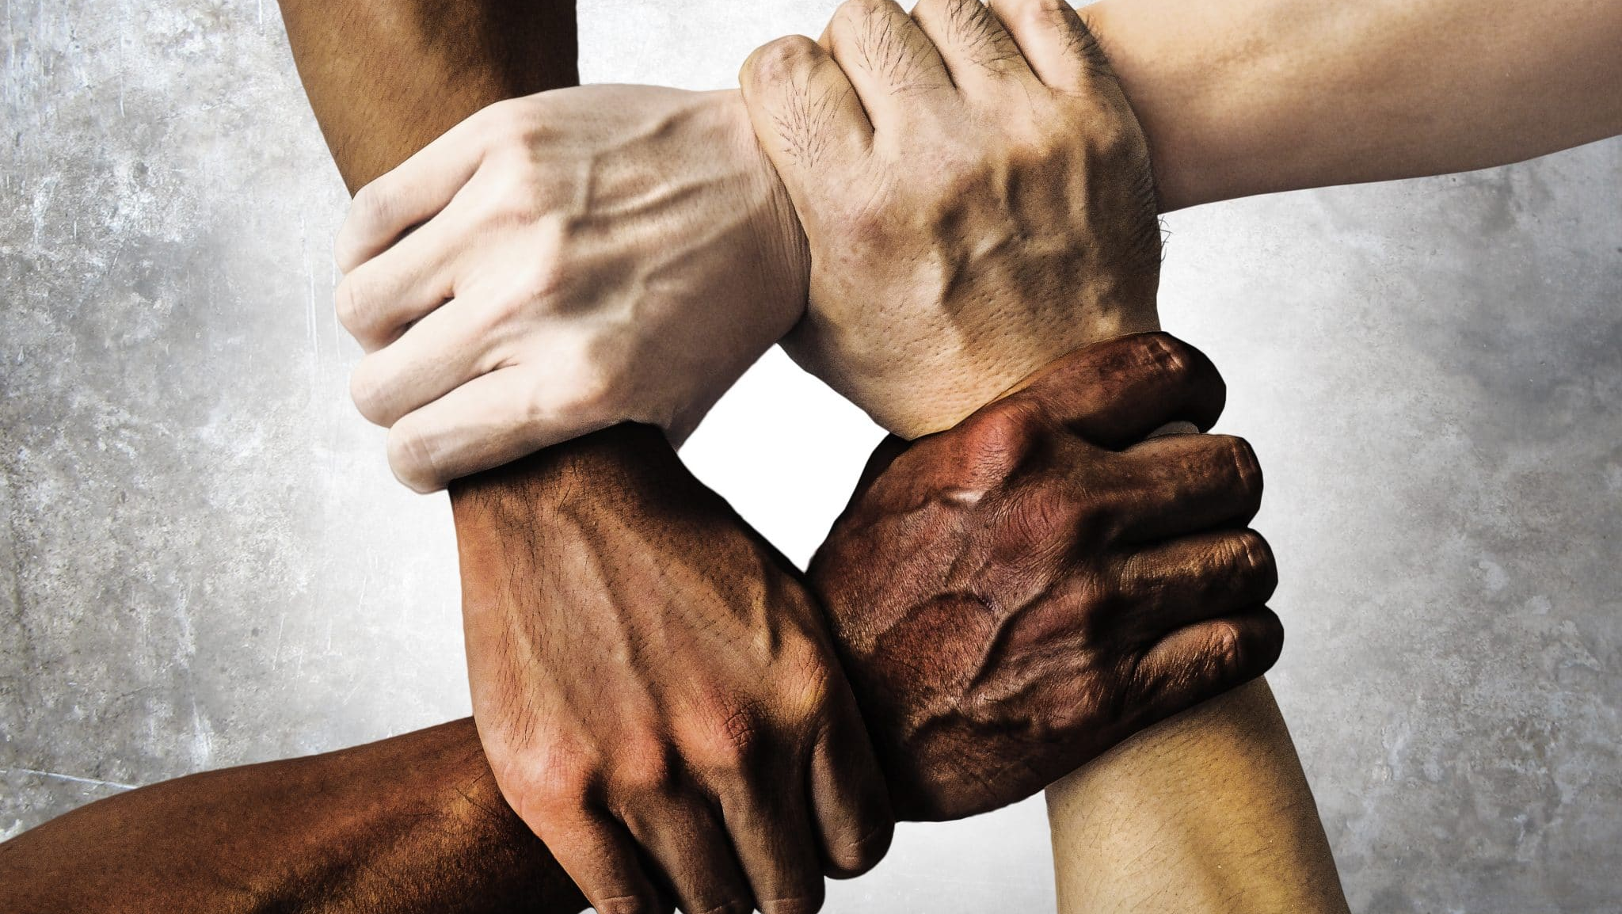
One new
community
Under the Father
Through the Son
By the Spirit

Slide 17
Ephesians 2:11-22
Don’t forget that you Gentiles used to be outsiders. You were called “uncircumcised heathens” by the Jews, who were proud of their circumcision, even though it affected only their bodies and not their hearts. In those days you were living apart from Christ. You were excluded from citizenship among the people of Israel, and you did not know the covenant promises God had made to them. You lived in this world without God and without hope.

Slide 18
Ephesians 2:11-22
But now you have been united with Christ Jesus. Once you were far away from God, but now you have been brought near to him through the blood of Christ.
For Christ himself is our peace. He united Jews and Gentiles into one people when, in his own body on the cross, he broke down the wall of hostility that separated us. He did this by ending the system of law with its commandments and regulations.

Slide 19
Ephesians 2:11-22
He made peace between Jews and Gentiles by creating in himself one new people from the two groups. Together as one body, Christ reconciled both groups to God by means of his death on the cross, and our hostility toward each other was put to death.
He brought this Good News of peace to you Gentiles who were far away from him, and peace to the Jews who were near. Now all of us can come to the Father through the same Holy Spirit because of what Christ has done for us.

Slide 20
Ephesians 2:11-22
So now you Gentiles are no longer strangers and foreigners. You are citizens along with all of God’s holy people. You are members of God’s family. Together, we are his house, built on the foundation of the apostles and the prophets. And the cornerstone is Christ Jesus himself. We are carefully joined together in him, becoming a holy temple for the Lord. Through him you Gentiles are also being made part of this dwelling where God lives by his Spirit.

Slide 21
Celebrating our diverse community
Every week, we will hear about a different nation represented in our family
We’ll find out some wonderful facts about their heritage
and culture
We’ll ask them to pray for us in their own language
We will continue to celebrate and enjoy the unique and glorious family that God has called us to be.

Slide 22
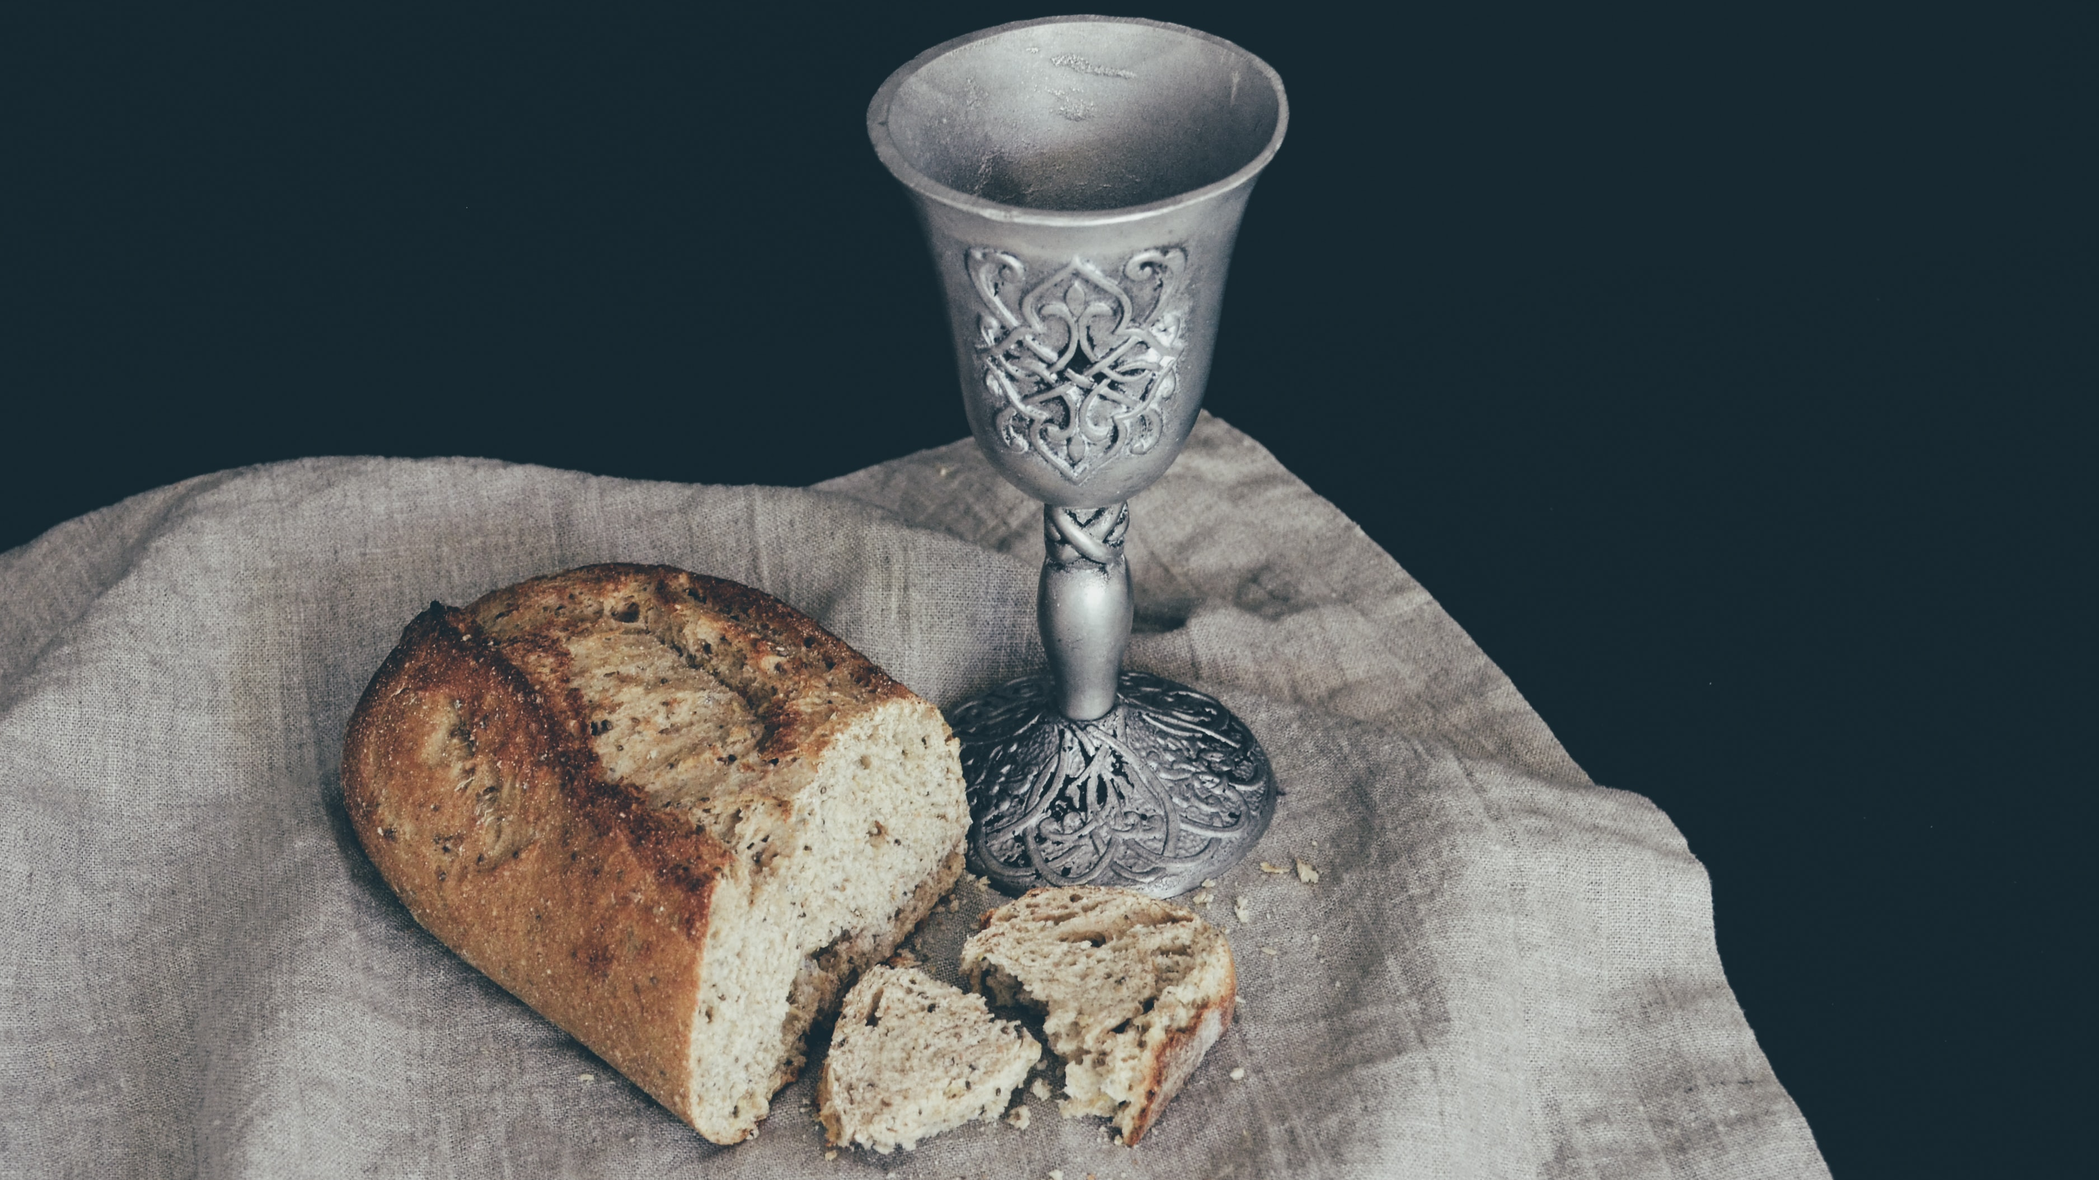

Slide 23
Jubilee Connects
Goodbye! Stay safe!
Hold onto Jesus
Connect with your Home Group
Look out for your neighbours

