Slide 1
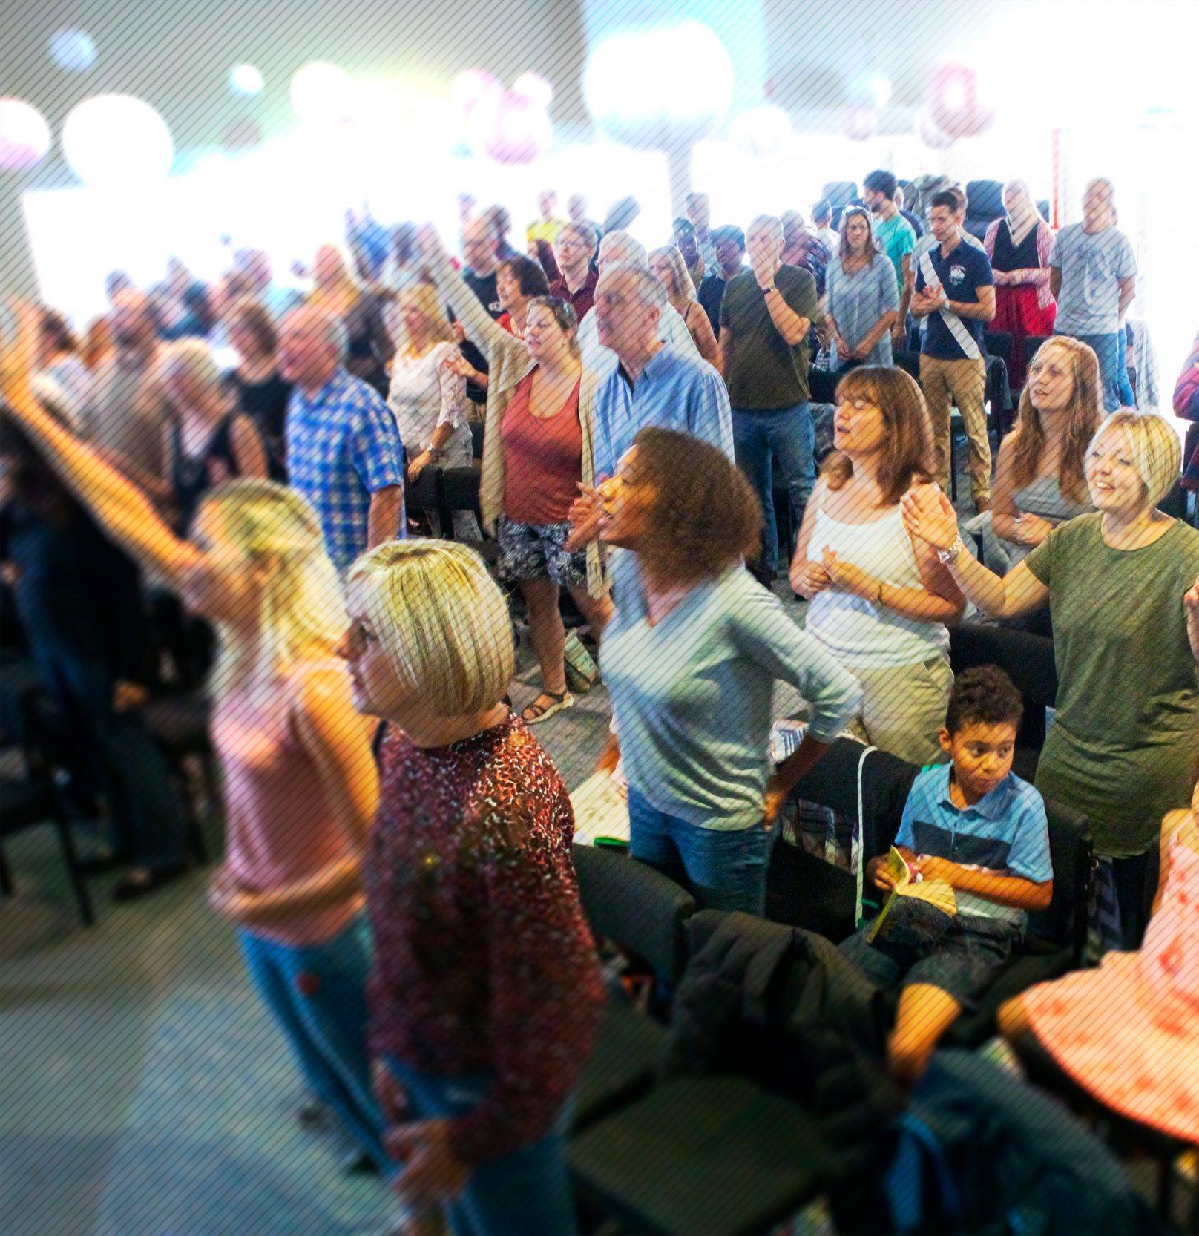
Jubilee Connects
Welcome to our virtual
Sunday gathering!
Enjoy the worship!
We’ll be starting shortly after 1030
Switch on your video so we can see you!
Please use a recognisable name onscreen.
You can send us all a message in the Chat window in Zoom but we’ve muted your voices to save background noise!

Slide 2
What’s in store today?
Announcements
Preach
Worship
Prayer
Special:
Baptism

Slide 3


Slide 4

Announcing…

Slide 5

12.00pm Tues 2nd June
Pilates with Phillipa
phillipagill@hotmail.com
12.30pm Thurs 4th June
‘Connectedness’
Hosted by Siji & Steve

Slide 6

Prayer Power Hour
Wednesday 3rd June
7.30 – 8.30pm
On Zoom
(Zoom link in weekly Office email)

Slide 7

Building Project
Information Evening
Thursday 4th June
7.30pm
On Zoom
The Elders will share encouraging developments and updates to the project.
(Zoom link in weekly Office email)

Slide 8

Rutland Woods
Work Party
Saturday 6th June
9am – 1pm
Maximum of 6 people
(only 4 spaces left)
Interested in joining?
Contact Tim Biddlecombe
tim.biddlecombe@jubilee.co

Slide 9

Worship

Slide 11

Fighting fear with faith
Prayer

Slide 12

Water Baptism
Kayla Atiti

Slide 13
Jubilee Connects
Goodbye! Stay safe!
Hold onto Jesus
Connect with your Home Group
Look out for your neighbours

