Slide 1
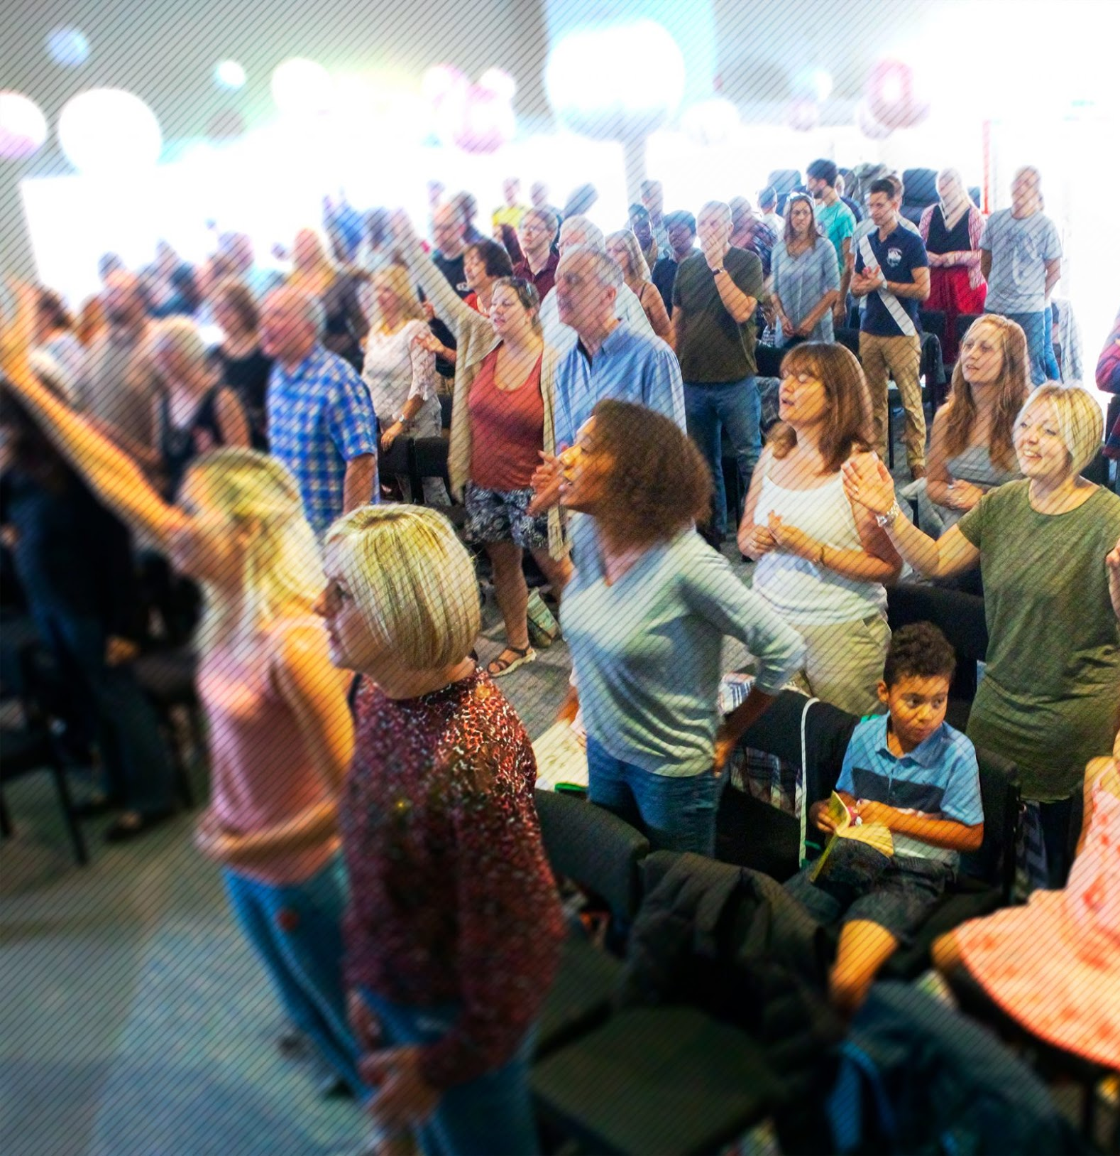
Jubilee Connects
Welcome to our virtual
Sunday gathering!
Enjoy the worship!
We’ll be starting shortly after 1030
Switch on your video so we can see you!
Please use a recognisable name onscreen.
You can send us all a message in the Chat window in Zoom but we’ve muted your voices to save background noise!

Slide 2





What’s in store today?
Story Time
Focus On: Maidstone Churches
Worship
Preach
Prayer
Announcements

Slide 3
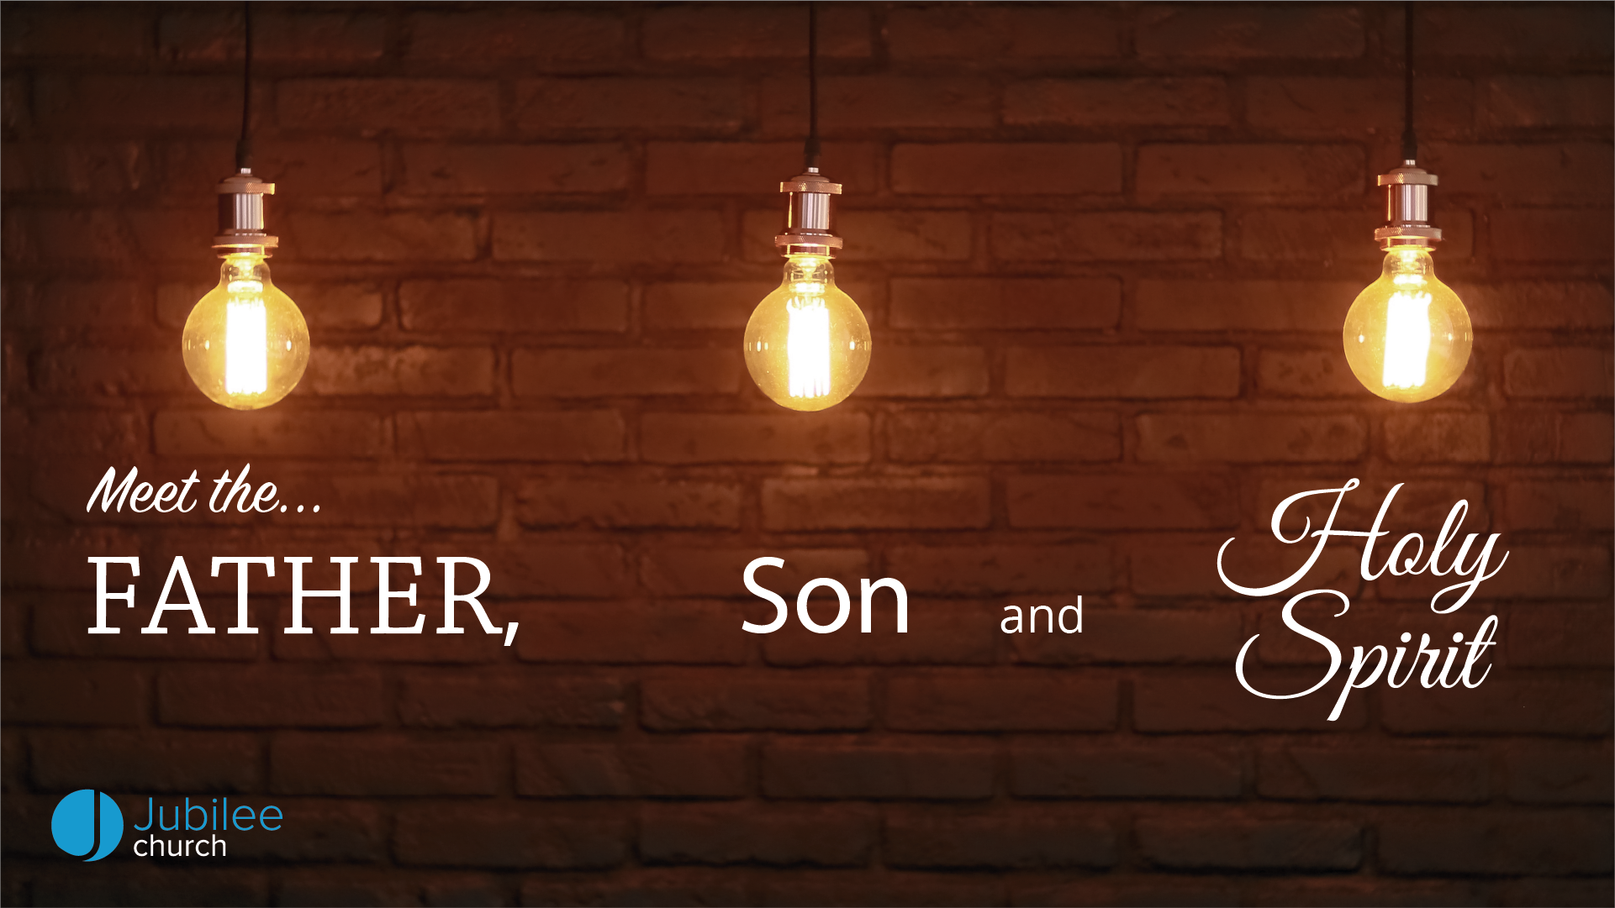

Slide 4
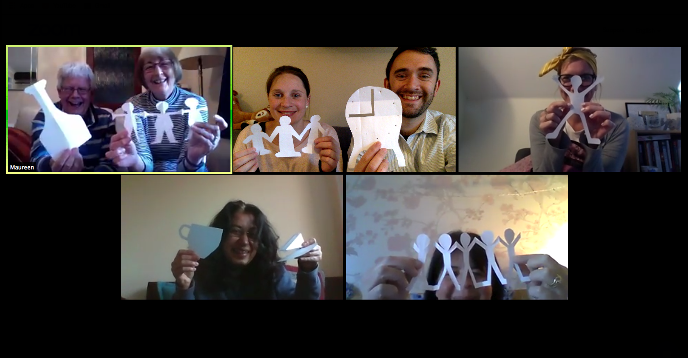
Stay Connected in Homegroups…
If you are new to Jubilee Church, reach out and say ‘hi’ at: office@jubilee.co

Slide 5

Fighting fear with faith
Storytime

Slide 6
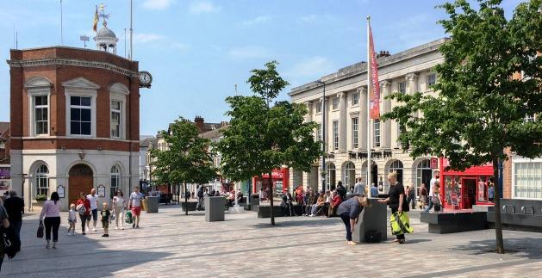
Fighting fear with faith
Church Unity in Maidstone

Slide 7

Testimonies

Slide 8

Fighting fear with faith
Prayer

Slide 9

Worship

Slide 11
Fighting fear with faith
Prayer

Slide 12

Announcing…

Slide 13
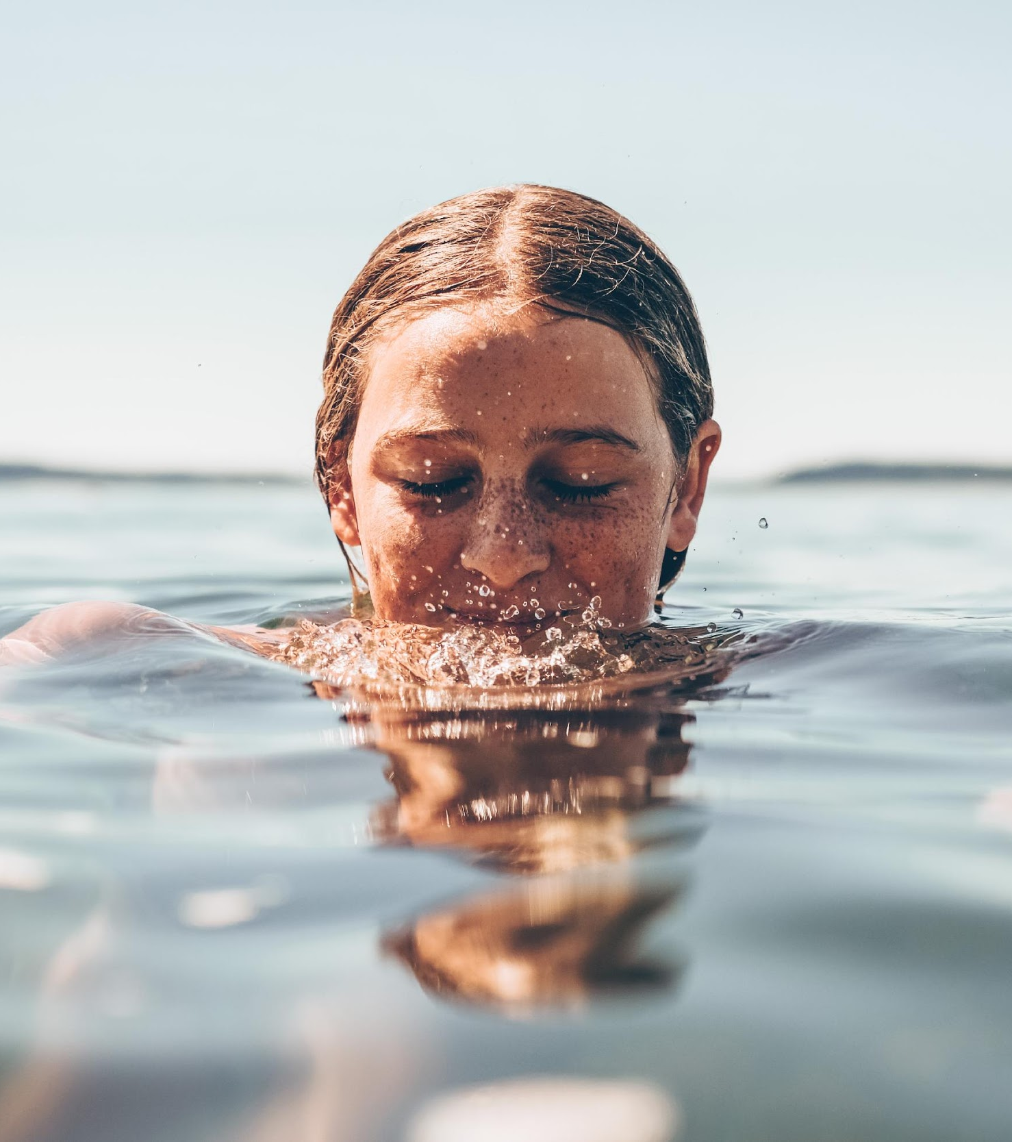
Water Baptisms
Baptismal Sunday
31st May
Want to get baptised?
Speak with your homegroup leader and let them know
or
Email office@jubilee.co

Slide 14

12.30pm Tues 26th May
Bible Devotional
With Neil & Steve
12.30pm Wed 27th May
Cooking with Giancarlo
Spaghetti a la carbonara

Slide 15
Jubilee Connects
Goodbye! Stay safe!
Hold onto Jesus
Connect with your Home Group
Look out for your neighbours

