Slide 1
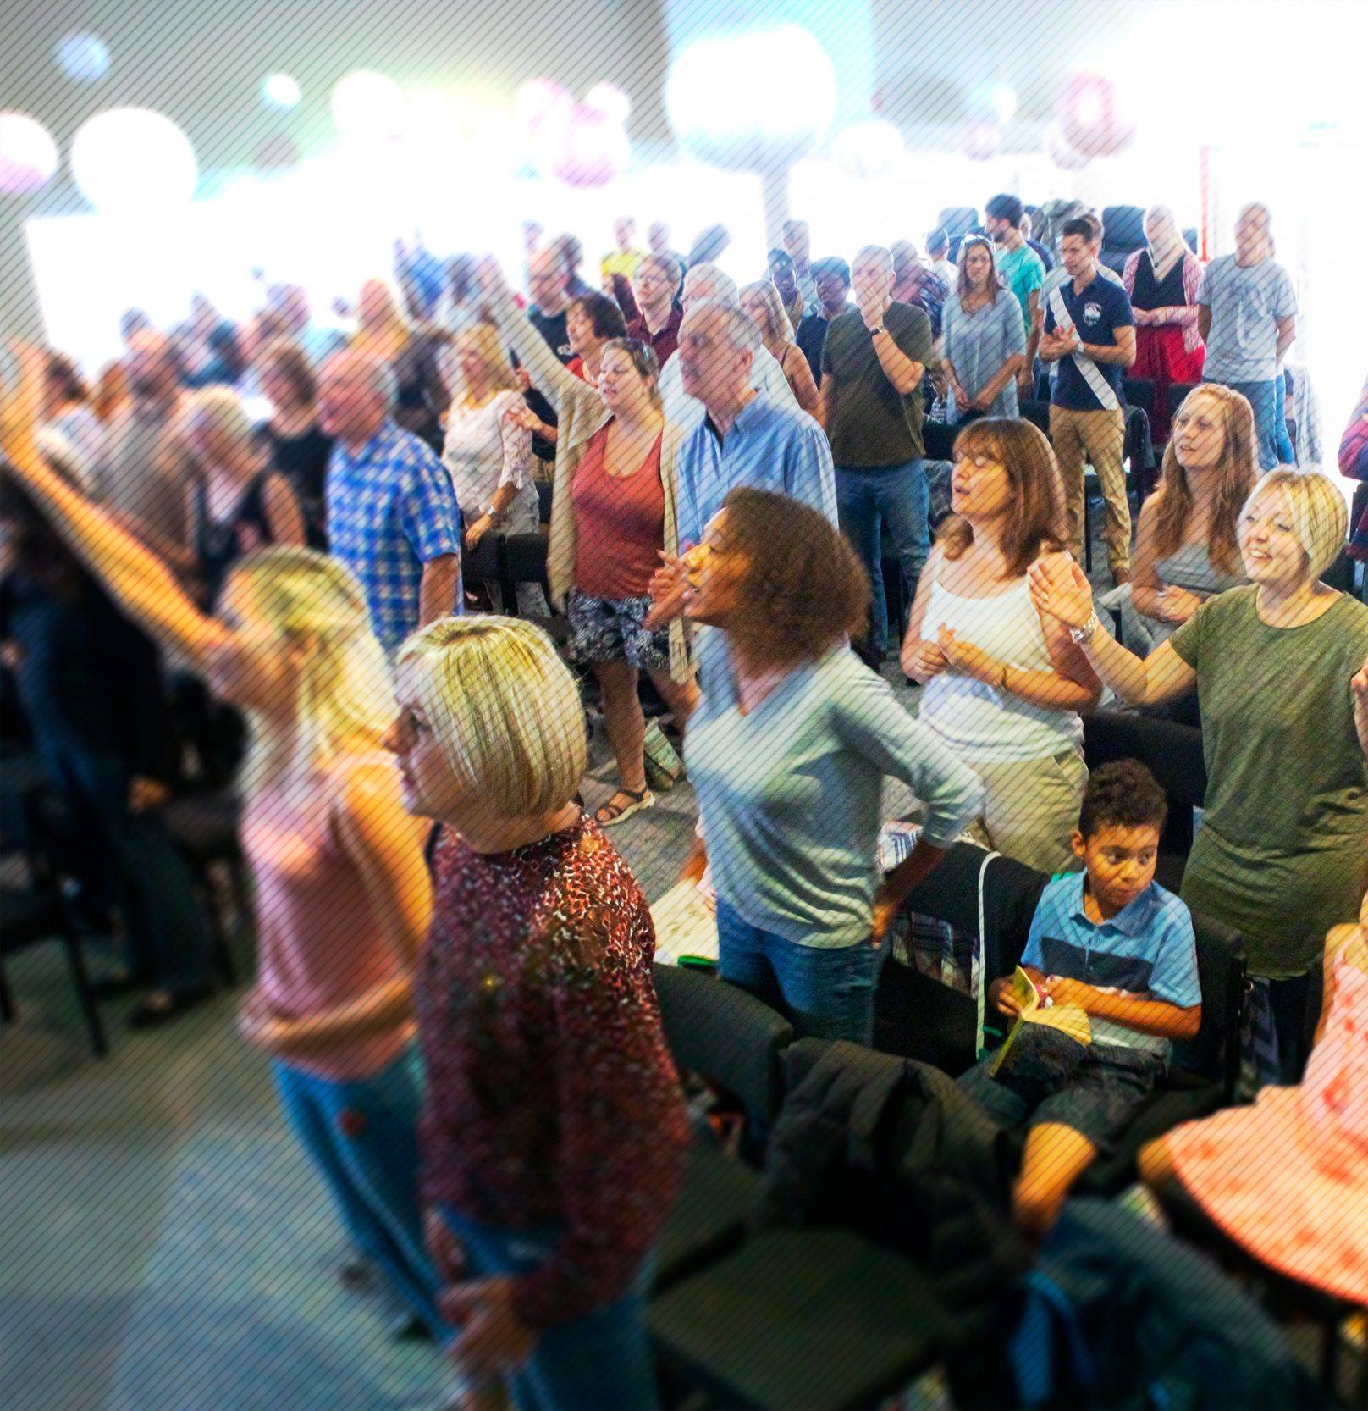
Jubilee Connects
Welcome to our virtual
Sunday gathering!
Enjoy the worship!
We’ll be starting shortly after 1030
Switch on your video so we can see you!
Please use a recognisable name onscreen.
You can send us all a message in the Chat window in Zoom but we’ve muted your voices to save background noise!

Slide 2
What’s in store today?
Announcements
Focus On: Church Unity
Preach
Worship
Prayer
Encouragement

Slide 3
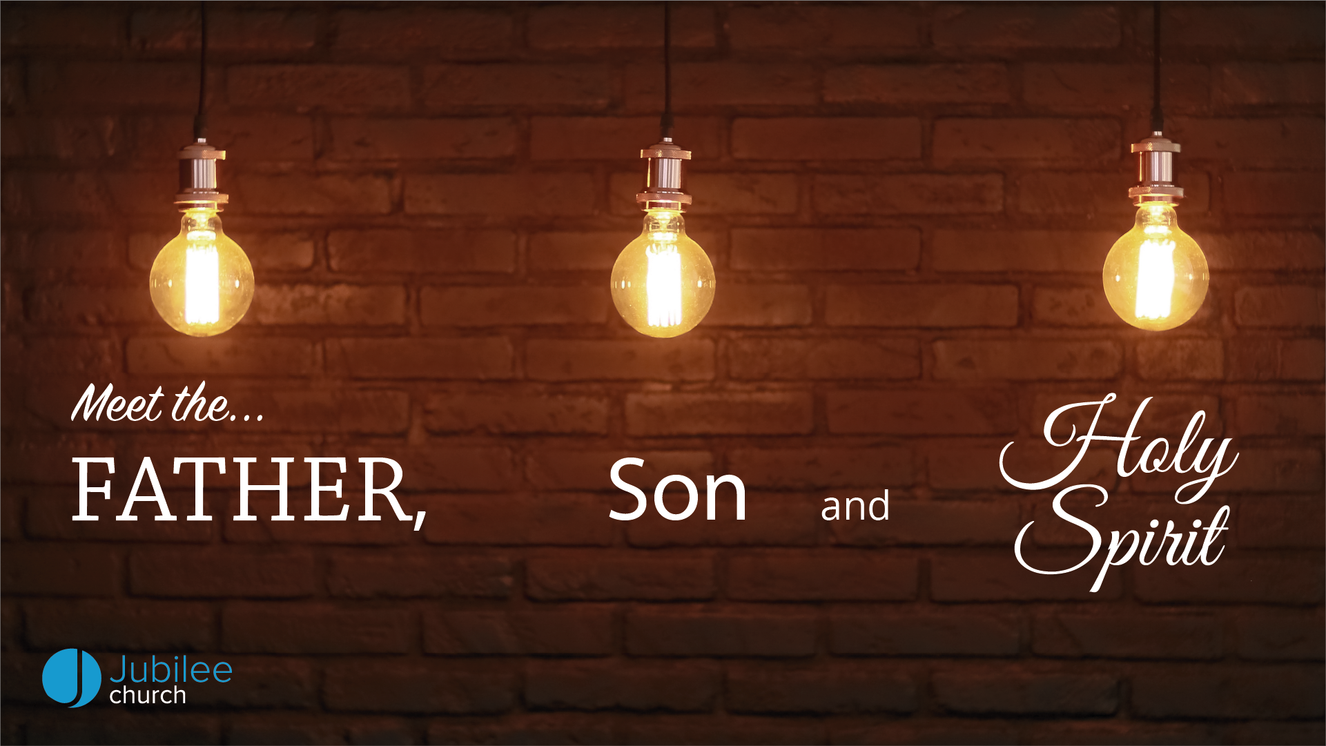

Slide 4

Happy Birthday!
Who has had a birthday in the last week or has one coming up?

Slide 5



Slide 6


Slide 7


Slide 8

Fighting fear with faith
Prayer

Slide 9


Slide 10

Worship

Slide 12
REVELATION
‘Revelation is the deliberate and active disclosure by God of something previously unknown which communicates real, but not exhaustive, knowledge.’
[theologian.co.uk]

Slide 13
1 JOHN 4:7-8
⁷ Dear friends, let us love one another, for love comes from God. Everyone who loves has been born of God and knows God. ⁸ Whoever does not love does not know God, because God is love.

Slide 14
1 CORINTHIANS 13:4-8
⁴ Love is patient, love is kind. It does not envy, it does not boast, it is not proud. ⁵ It does not dishonour others, it is not self-seeking, it is not easily angered, it keeps no record of wrongs. ⁶ Love does not delight in evil but rejoices with the truth. ⁷ It always protects, always trusts, always hopes, always perseveres. ⁸ Love never fails.

Slide 15
REVELATION IS A PERSONAL CONFRONTATION
‘When we meet His Word, we meet God, and are called to respond to Him as the Author of that Word.’

Slide 16
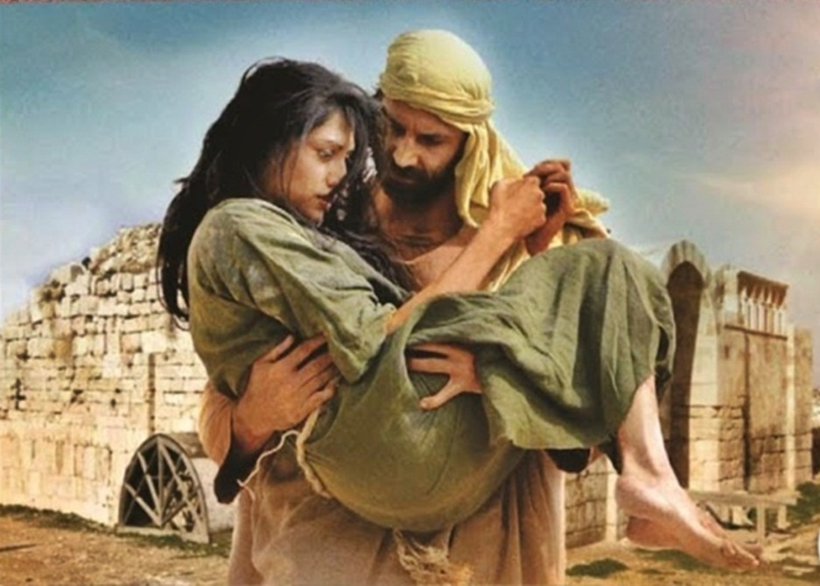
THE STORY OF HOSEA AND GOMER

Slide 17
JESUS REVEALS GOD
JOHN 1:18
No one has ever seen God, but the one and only Son, who is himself God and is in closest relationship with the Father, has made him known.

Slide 18
JESUS REVEALS GOD
JOHN 14:9-10
⁹ Jesus answered: “Don’t you know me, Philip, even after I have been among you such a long time? Anyone who has seen me has seen the Father. How can you say, ‘Show us the Father’? ¹⁰ Don’t you believe that I am in the Father, and that the Father is in me? The words I say to you I do not speak on my own authority. Rather, it is the Father, living in me, who is doing his work.

Slide 19
ROMANS 5:8
But God demonstrates his own love for us in this: While we were still sinners, Christ died for us.

Slide 20
EPHESIANS 2:8-9
⁸ For it is by grace you have been saved, through faith—and this is not from yourselves, it is the gift of God— ⁹ not by works, so that no one can boast.

Slide 21
PSALM 18:3
I called to the Lord, who is worthy of praise,
and I have been saved from my enemies.

Slide 22
GALATIANS 5:22-23
²² But the fruit of the Spirit is love, joy, peace, patience, kindness, goodness, faithfulness, ²³ gentleness and self-control. Against such things there is no law.

Slide 23
I WILL BE FOUND BY YOU…
JEREMIAH 29:13
¹³ You will seek me and find me when you seek me with all your heart. ¹⁴ I will be found by you,” declares the Lord
PROVERBS 8:17
I love those who love me,
and those who seek me find me.

Slide 24
Fighting fear with faith
Prayer

Slide 25

Announcing…

Slide 26
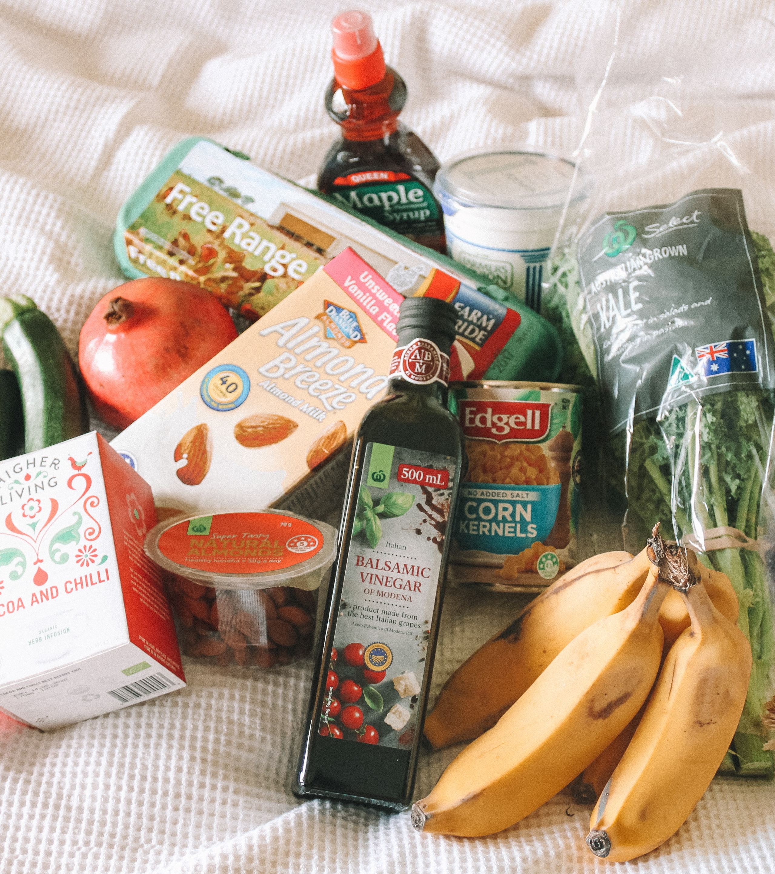
Reaching Maidstone
If you want to assist the local food banks, please transfer your gift into the Restoring Hands bank account with reference ‘Food Bank’ and we will pass it on. This ensures provision of specific foods & items most needed.
Restoring Hands
Sort Code: 40-31-06
Account Number: 12746409

Slide 27


BIBLE CHAT ROOM
What Does the Bible Say?
Hosted by Ray & Jacqui Skilton
Guest panel: Neil, Darren & Brian
Topic: Rivers of Living Waters
(Ez 47:1-12; John 7:38-39; Rev 22:1-2)
Tuesday 12th May
11.00am
(Zoom link to come in weekly email)

Slide 28

12.30pm Tuesday 12th May
‘Learn how to do lettering’
With Esther Simmons
7.45pm Tuesday 12th May
‘Single Parenting in Lockdown’
With Molly & Sophya
3.30pm Wednesday 13th May
Franksie’s Kitchen
Baking biscuits with children
12.30pm Thursday 14th May
‘Meet the Team: Dan & Claire’
Hosted by Steve & Siji

Slide 29

12.30pm Tuesday 12th May
‘Learn how to do lettering’
With Esther Simmons

Slide 30
12.30pm Tuesday 12th May
‘Learn how to do lettering’
With Esther Simmons
7.45pm Tuesday 12th May
‘Single Parenting in Lockdown’
With Molly & Sophya
3.30pm Wednesday 13th May
Franksie’s Kitchen
Baking biscuits with children
12.30pm Thursday 14th May
‘Meet the Team: Dan & Claire’
Hosted by Steve & Siji

Slide 31
Jubilee Connects
Goodbye! Stay safe!
Hold onto Jesus
Connect with your Home Group
Look out for your neighbours

