Slide 1
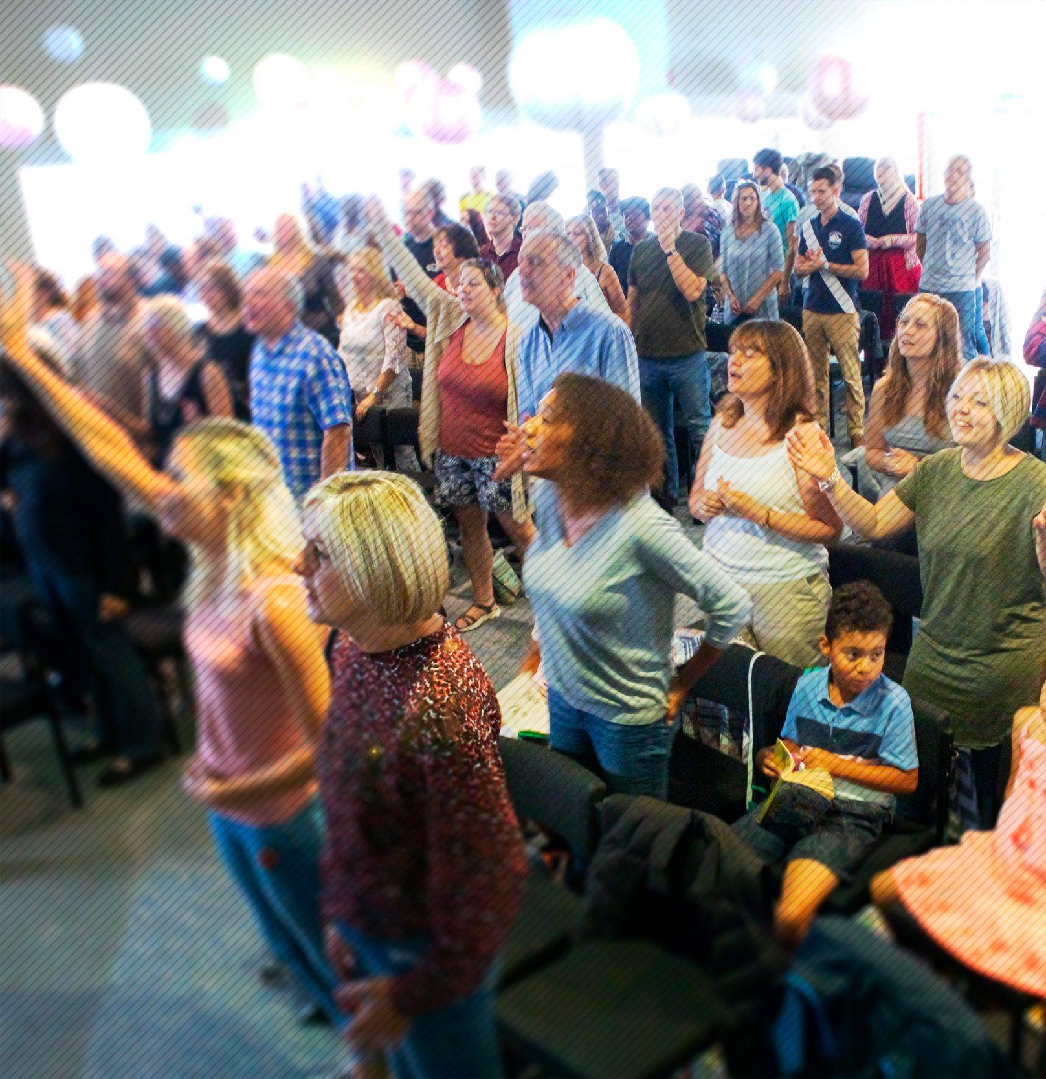
Jubilee Connects
Welcome to our virtual
Sunday gathering!
Enjoy the worship!
We’ll be starting shortly after 1030
Switch on your video so we can see you!
Please use a recognisable name onscreen.
You can send us all a message in the Chat window in Zoom but we’ve muted your voices to save background noise!

Slide 2
What’s in store today?
Children's Spot
Announcements
‘Easter Gospel’
Worship
Let’s Get Creative
Prayer

Slide 3

Happy Birthday!
Who has had a birthday in the last week or has one coming up?

Slide 4

The Easter Story:
By Joseph Liam

Slide 5

The Passover:
Last plague in Egypt – death of the firstborn.
People put the blood of the lamb on the sides and on the tops of the doorframes of the houses of each family.
The Pharaoh let the Israelites go. That day was called the Passover, which is part of Easter.
Interesting fact: On the Passover, every family which had put blood on their doorframes had to stay home. And today we also must stay home, could it be that God is telling us something?

Slide 6
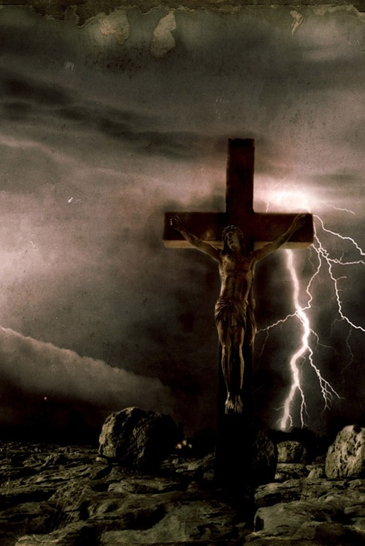
Easter:
Humanity was lost, then Jesus came as the Lamb of God and died for all of us.
Jesus had to die so all our sins could be forgiven.
On a dark night, Jesus was crucified. His sacrifice allowed us to be protected and saved, instead of put blood on the doorframes of our houses.
Three days later, Jesus rose from the dead. On the next day he went to see his disciples and after that he went to heaven. That week is known as Easter.

Slide 7
Thank you for listening… ☺

Slide 8
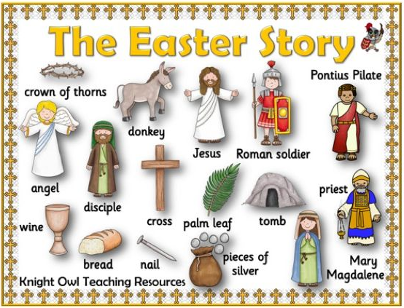
For our POD children!

Slide 9

Let’s get creative!

Slide 10

Worship

Slide 11
Living Hope by Phil Wickham
Verse 1
How great the chasm that lay between us
How high the mountain I could not climb
In desperation I turned to heaven
And spoke Your name into the night
Then through the darkness
Your loving-kindness
Tore through the shadows of my soul
The work is finished the end is written
Jesus Christ my living hope
Verse 2
Who could imagine so great a mercy
What heart could fathom such boundless grace
The God of ages stepped down from glory
To wear my sin and bear my shame
The cross has spoken I am forgiven
The King of kings calls me His own
Beautiful Savior I’m Yours forever
Jesus Christ my living hope
Chorus
Hallelujah praise the One who set me free
Hallelujah death has lost its grip on me
You have broken every chain
There’s salvation in Your name
Jesus Christ my living hope
Verse 3
Then came the morning that sealed the promise
Your buried body began to breathe
Out of the silence the Roaring Lion
Declared the grave has no claim on me
(REPEAT)
Jesus Yours is the victory

Slide 12
O Praise the Name by Hillsong
Verse 1
I cast my mind to Calvary
Where Jesus bled and died for me
I see His wounds His hands His feet
My Saviour on that cursed tree
Verse 2
His body bound and drenched in tears
They laid Him down in Joseph’s tomb
The entrance sealed by heavy stone
Messiah still and all alone
Chorus
O praise the Name
Of the Lord our God
O praise His Name
Forevermore
For endless days
We will sing Your praise
Oh Lord oh Lord our God
Verse 3
Then on the third at break of dawn
The Son of heaven rose again
O trampled death where is your sting
The angels roar for Christ the King
Verse 4
He shall return in robes of white
The blazing sun shall pierce the night
And I will rise among the saints
My gaze transfixed on Jesus’ face

Slide 13
‘Easter Gospel’
Darren Eagles

Slide 14
Easter Message
Today is the day of salvation
Who’s in and who’s out?
Good is never good enough
The Divine exchange
What do I do now?

Slide 15

Fighting fear with faith
Prayer of Salvation
Dear Lord Jesus, thank you for dying on the cross for my sin. Please forgive me. Come into my life. I receive You as my Lord and Saviour. Now, help me to live for you the rest of this life. In the name of Jesus.
Amen.

Slide 16
If you responded to the Easter message and want more information…
Email: darren.eagles@jubilee.co
Or the Jubilee office: office@jubilee.co
Join a Home Group or let your Home Group leader know
Alpha course

Slide 17
Fighting fear with faith
Prayer

Slide 18

Announcing…

Slide 19

12.30pm Tuesday 14th April
‘How to get into the Word’
Steve and panel
12.30pm Thursday 16thApril
‘What does God think of the virus?’
Neil and panel

Slide 20


Alpha
Tuesdays
Starting 21st April
7.30pm
10 weeks
For more information or to sign up, contact:
Steve & Kim
(steve.lee@jubilee.co)

Slide 21
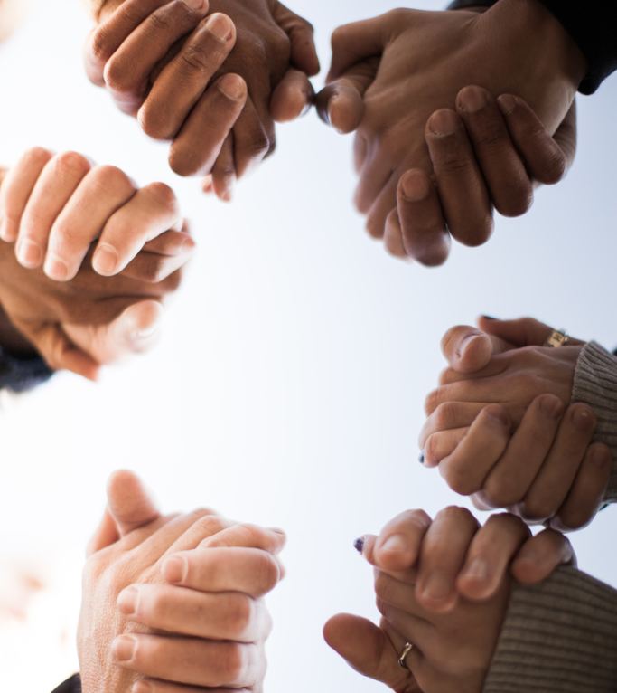
Prayer Power Hour
Wednesday 15th April
7.30 – 8.30pm
On Zoom

Slide 22
Jubilee Connects
Goodbye! Stay safe!
Hold onto Jesus
Connect with your Home Group
Look out for your neighbours

